Slide 1
An eye catcher in the ATC domain: Influence of Multiple Remote Tower Operations on distribution of eye movements.
Maik Friedrich
Anneke Hamann
Joern Jakobi

Slide 2
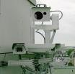
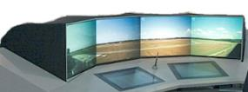
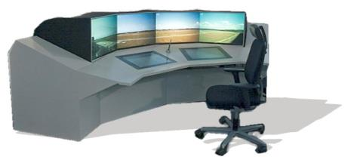
Multiple Remote Tower Module (MRTM)
Remote Tower for several airports
Air Traffic Service provided to a medium sized airport (Vilnius / main airport ) and two small airports (Kaunas and Palanga/ second and third)
To makes smaller airports with low traffic rates more cost efficient
Equally distributed and constant activity for Air Traffic Control Officers (ATCO)
Three panoramic views (PV) at the same time
Main airport
Second airport
Third airport

Slide 3
Motivation
Is the distribution of eye movements influenced by the workload of Multiple Remote Tower Operations?

Slide 4
Key Parameters that influence Air Traffic Control (ATC) in normal conditions for Multiple Remote Tower Operations
Key Parameters
Traffic volume
Traffic complexity
Traffic distribution
Operational modes
Runway conditions
Wind conditions
Visibility conditions
Time of the day
Notes:
You can see them in the darker blue circles.
What you also recognize is, that there are a lot of things that can vary. Take for instance the Time of the day or the visibility conditions. The traffic volume. When do you know when the amount of traffic is too high? There is Traffic complexity which includes the proportion of IFR and VFR. The traffic distribution indicates if you have the same amount of traffic at each aerodrome or if it is different. Then of course you have operational modes that can be normal, abnormal or even degraded. Runway conditions can be very different from aerodrome to aerodrome, as can be wind conditions.

Slide 5
The Research Questions in relation to mental workload during working at a Multiple Remote Tower Module
RQ1: Is the amount of traffic connected to the subjective mental workload?
We hypothesize that more traffic leads to an increase in subjective workload.
RQ2: How does the arrangement of information influence the dwell time on the different Areas of Interest (AoI)?
We hypothesize that the information gathering process is changed, especially the distribution of dwell time onto the MRTM.
RQ3: Is the subjective rating of mental workload correlated with the selected eye-tracking metrics?
We assume that the selected metric will show a connection to the subjective measurement.

Slide 6
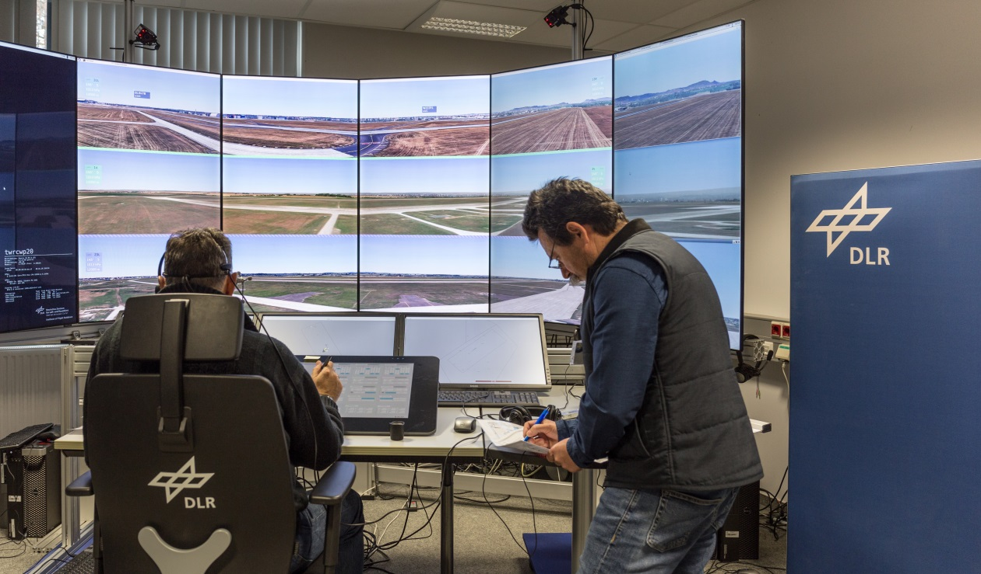
Participants (2 Groups)
First Group
6 Hungarian ATCOs (2 female, 4male)
Age between 29 and 59 years (M = 42.6; SD = 9.5)
Work experience average 17.7 years (SD = 9.6; MIN = 7; MAX = 36)
March 12th to November 22th, 2018
Second Group
6 Lithuanian ATCOs (all male)
Age between 25 and 36 years (M = 29.3; SD = 3.7)
Work experience average 3.7 years (SD = 2.4; MIN = 1; MAX = 8)
March 19th to March 27th, 2018

Slide 7
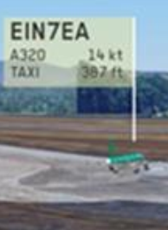
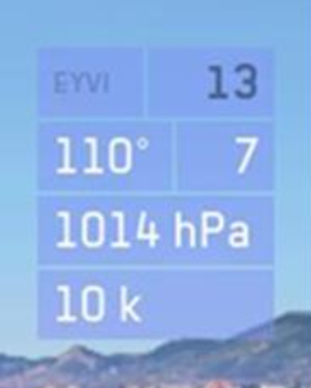
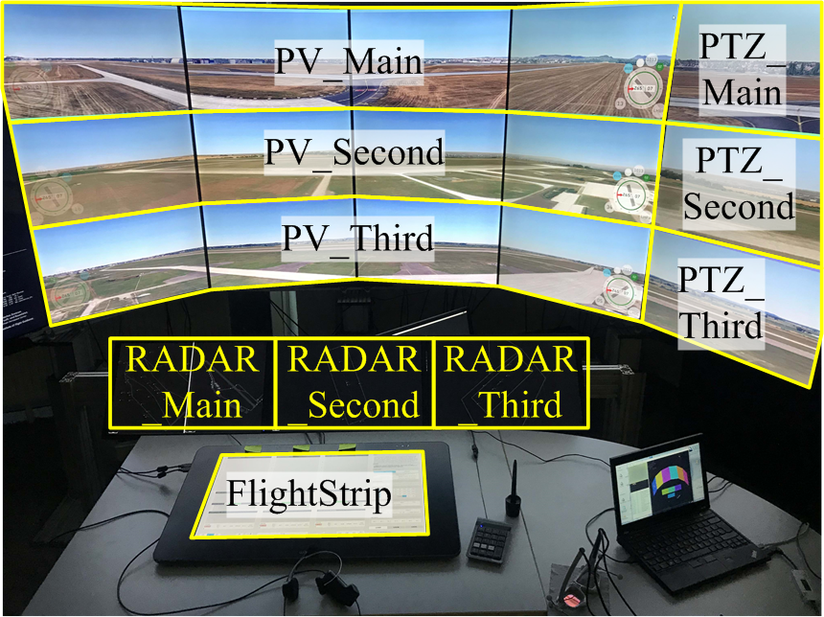
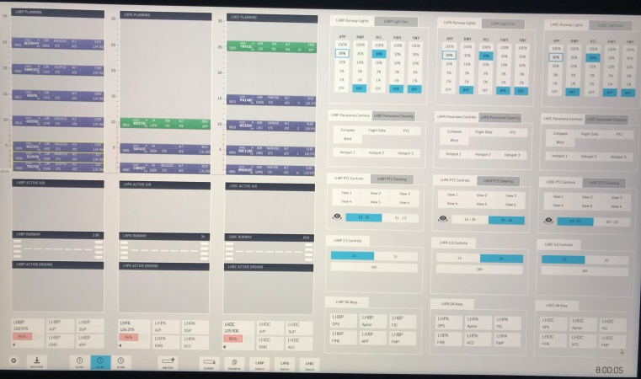
MRTO test environment
Narsim realtime simulation platform (DLR)
displayed on a 208° horizontal and 32° vertical video panorama,
extended by a 52° horizontal and 32° vertical pan-tilt-zoom camera on each airport
distinction of the aerodromes was visually enabled by a color code frame
Extended by an electronic smart-strip planning tool (Frequentis)
Frequencies (ground- and air) were coupled

Slide 8
Independent Variables and Scenarios
between-subject design was used with the factors
arrangement of information (Main_Top/Main_Bottom)
traffic amount (Traffic Group 20 / 28)
Scenarios had slightly different scheduled traffic to minimize learning effects
The Operational modes were always normal
Scenario | N° Aerodromes | Time | Traffic Volume (in mov/h)
SCN 1 | 2 | 00:40 | 20
SCN 2 | 3 | 00:50 | 20/28
SCN 3 | 3 | 00:50 | 20/28
SCN 4 | 3 | 00:50 | 20/28
SCN 5 | 3 | 00:50 | 20/28

Slide 9
Fixed Variables for all Scenarios
Variable name | Description
Traffic Distribution | Main: 50%; Second = 25%; Third = 25%
Traffic Mixture | 90% traffic with instrument flight rules, IFR
Runway Conditions | Similar runway conditions, no icing
Wind Conditions | Similar wind conditions
Visibility Conditions | Similar VMC conditions
Time of the day | Daytime at all airports

Slide 10
Procedure
ATCOs participated pair-wise
Briefing
ATCOs were briefed together
Training
30-40 minutes per ATCO
Simulation runs per ATCO
One ATCO controlled the aerodromes actively
After each simulation run
Active ATCO completed a post-run questionnaire
Debriefing
Post-exercise questionnaire
Final interview
Completed ISA scale

Slide 11
Data Analysis
Workload
ISA scale is a 5 value scale (1 = underutilized, 2 = relaxed, 3 = comfortable, 4 = high, 5 = excessive)
Past 5 Minutes
Eye-tracking
analyzed by a velocity-based fixation detection algorithm to separate fixations and saccades
Velocity threshold was defined individually as the fastest five percent of movements
Only the first 40 minutes of each run were used

Slide 12
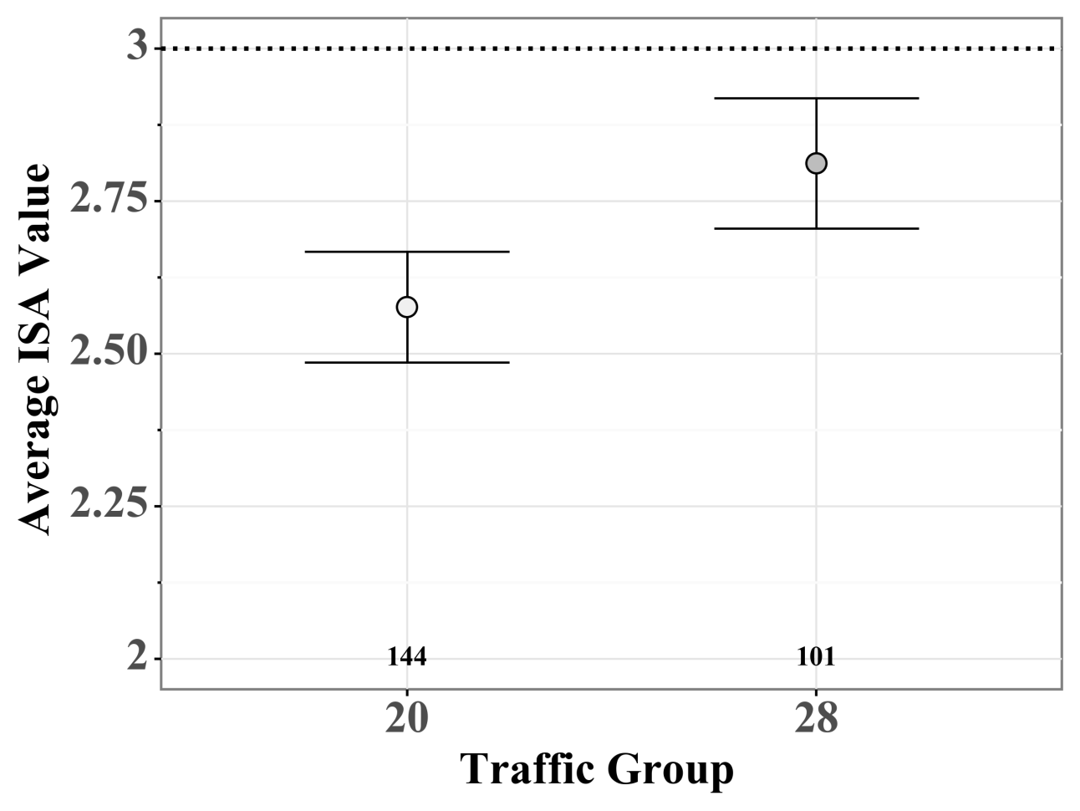
Results - Connection between amount of traffic and subjective workload
a total of 245 measurements
underutilized was selected in 15.9 % (25 in group 20 and 14 in group 28)
excessive was selected in 2.8 % (2 in 20 and 5 in 28)
in average, group 28 classified the workload as higher and closer to the optimum of “comfortably busy” than the participants in group 20
Average ISA score per traffic group

Slide 13
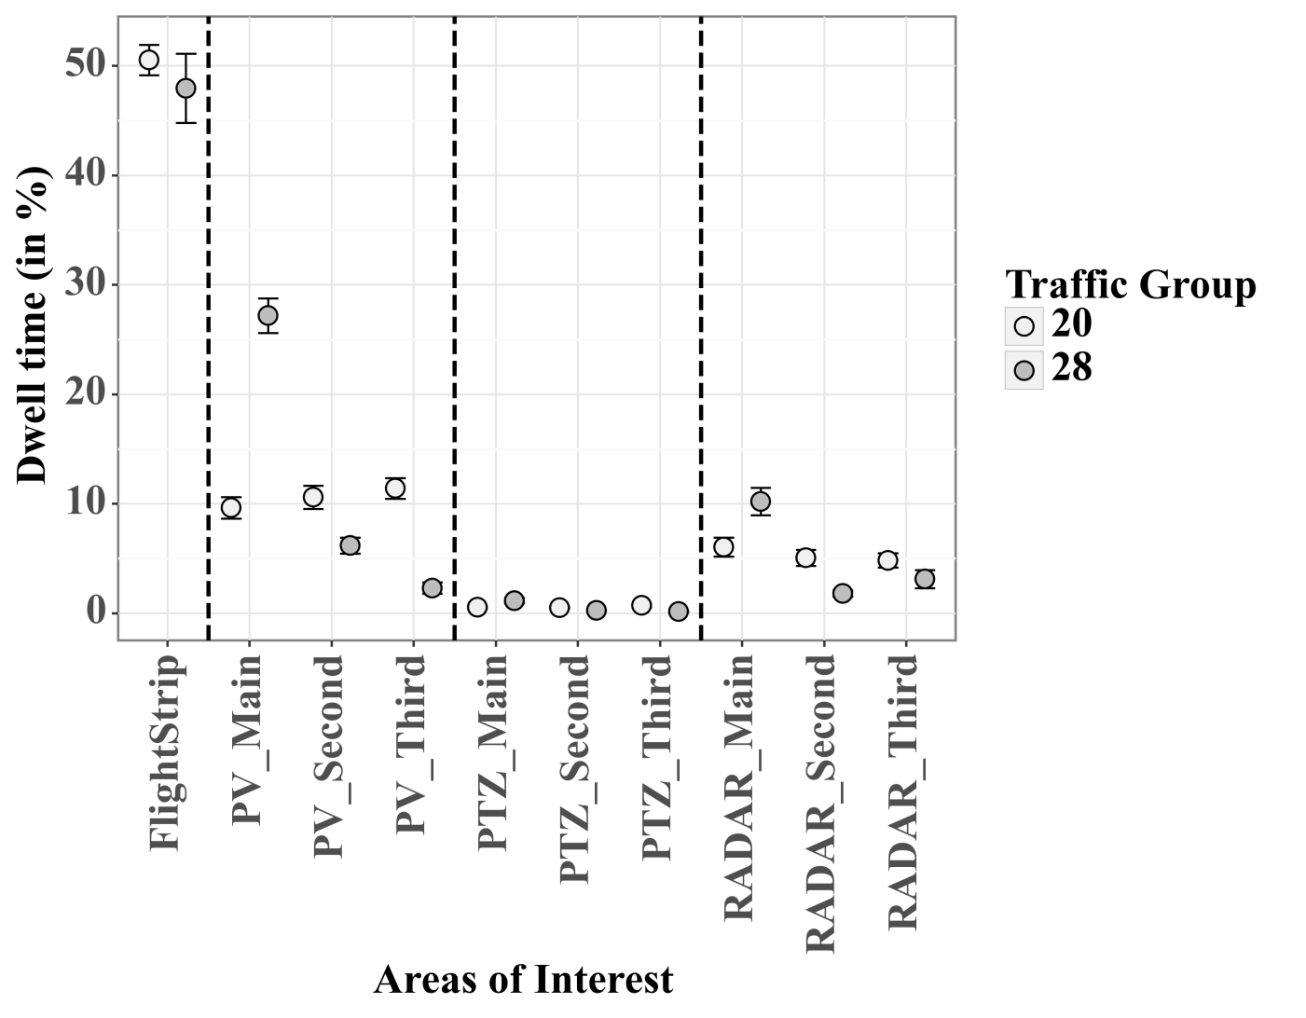
Results - Distribution of the Areas of Interest The arrangement of information influences the dwell time
Dwell time in percentage for each AOI per traffic group.
Invalid eye data of each participant was removed
Dwell times were calculated in percentage for each participant
The dwell times for traffic group 20 (Main_Top) show almost the same ratio in attention distribution for each panoramic view
The dwell times for traffic group 28 (Main_Bottom) show that the attention is distributed in connection to the traffic handled

Slide 14
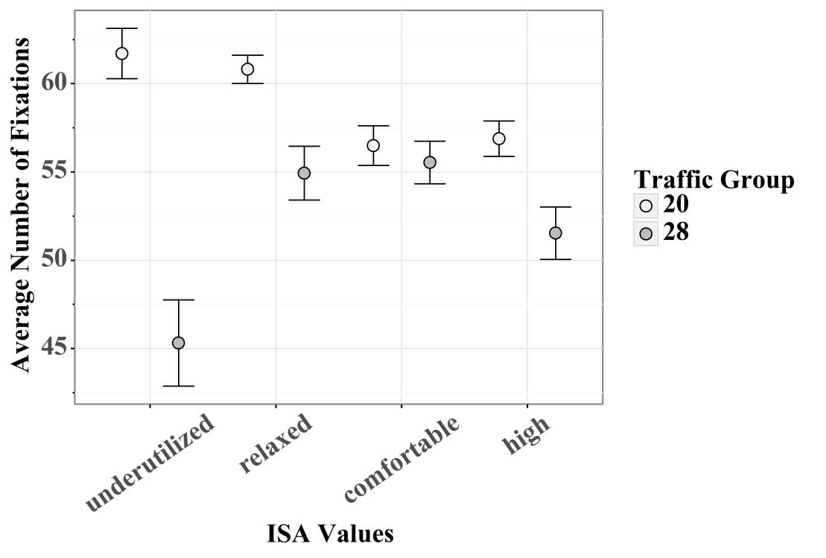
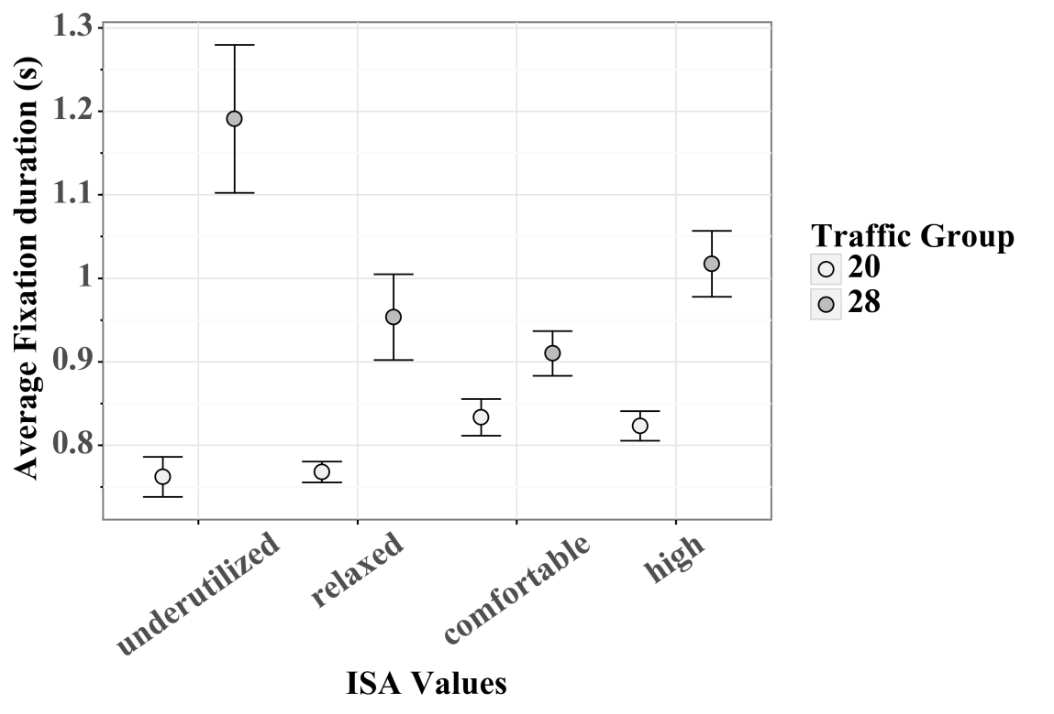
Results - Amount of fixation and average duration against the ISA scale
The time before a valid ISA answer was divided into 5 one-minute segments
for these segments the average number of fixations and average duration were calculated
The two analyses indicate that reduced workload leads to a higher number of shorter fixations

Slide 15
Discussion
Amount of Traffic Connected to Subjective Workload
Arrangement of Information
The results show that the amount of traffic increases the subjective workload
for both traffic groups and therefore also for both arrangements of information
The participants were more often insufficiently challenged
The distribution of dwell time per AoI varies for each traffic group
Traffic group 20 suggests an equal monitoring of the PV view for each airport
Traffic group 20 had to visually cross PV_Second and PV_Third while switching between PV_Main and FlightStrip
Group 28 could switch between PV_Main and FlightStrip without crossing any other PV

Slide 16
Discussion
Subjective Rating in Connection to Eye-tracking Metric
Results corresponded with the arrangement of information, because the participants in traffic group 28 pay more attention to the PV_Main.
For both groups, at low subjective workload the number of fixations and the duration of fixation indicate that they monitor less AoIs for a longer period
The effect is reduced when workload increases to a medium level

Slide 17
Summary
and
Outlook
This explorative study aimed at the evaluation of three RQ in relation to the MRTO workplace
Scan paths with the less important AoIs in between seems more promising with this study
The successful application of eye metrics depends on the scan path and on the arrangement of information, but seems predictable for a fixed set-up
Future work should concentrate on an experimental design that allows for inferential static analysis of the single factors that are described in this paper

Slide 18
Thank you

Slide 19
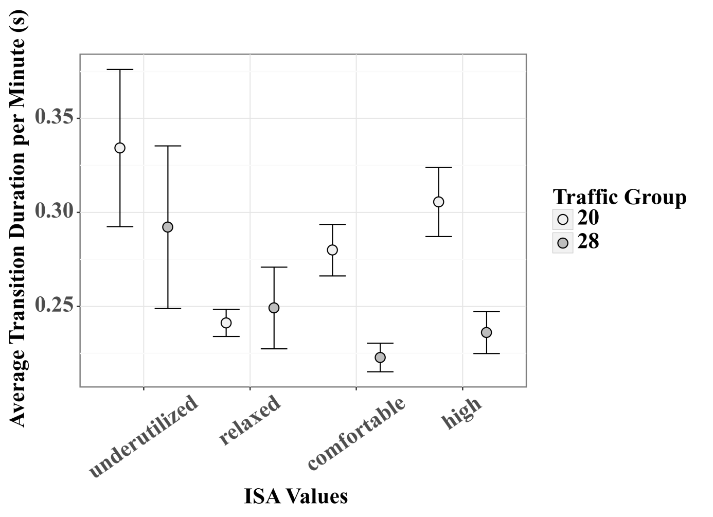
Results – Transition frequency The amount of transition and average duration against the ISA scale
The task of MRTO is strongly connected to the order in which the ATCO gathers information from the workplace.
number of transitions between AoIs and the average transition duration was selected as possible metric for the following analysis
Average transition duration of fixations per ISA values

