Slide 1
Arrival Flight Efficiency in Numbers: What New the Covid-19 Crisis is Bringing to the Picture?
Henrik Hardell, LIU
Anastasia Lemetti, LIU
Tatiana Polishchuk, LIU

Slide 2
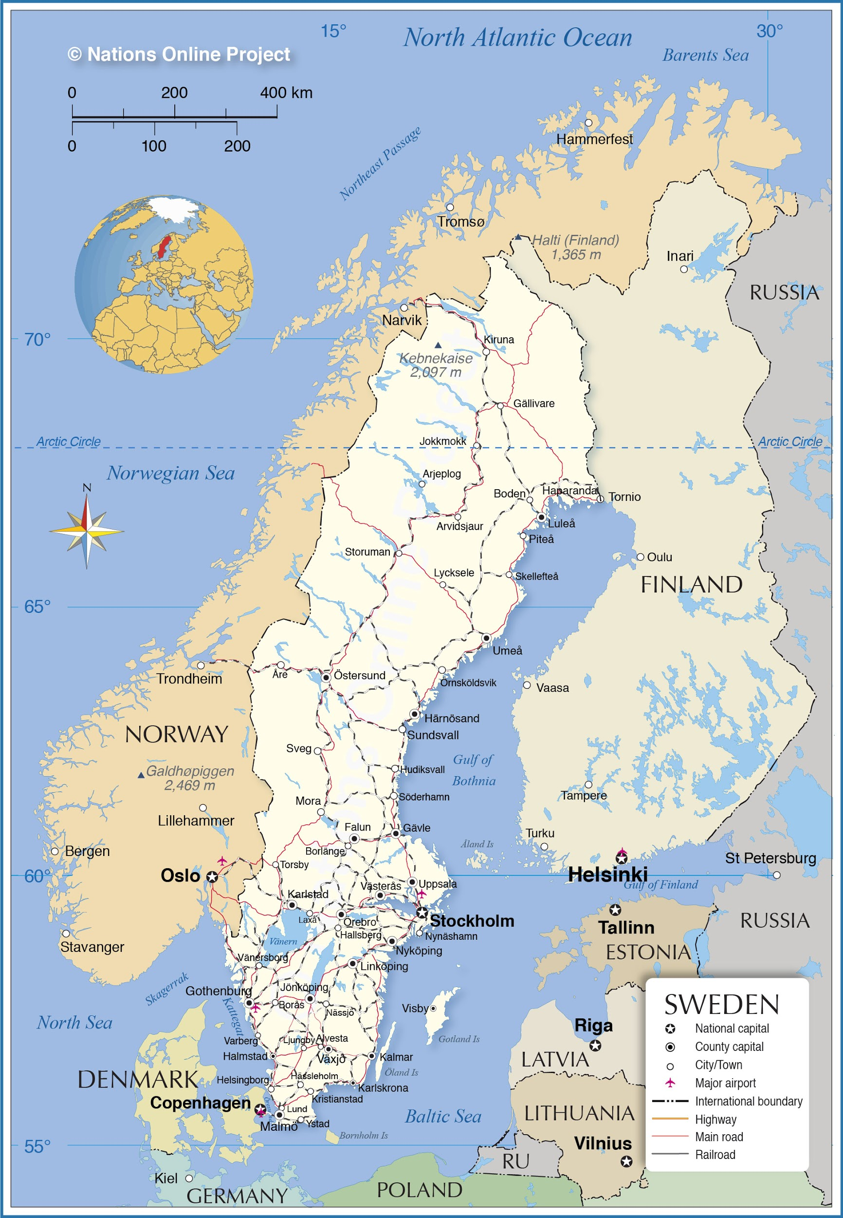
Stockholm Arlanda Airport
Stockholm Arlanda (ESSA)
Focus on TMA
March-July 2020
March-July 2019
Supported by the SESAR Joint Undertaking under the European Union’s Horizon 2020 research and innovation programme under grant agreement No 783287.

Slide 3
Data
Flight trajectories
OpenSky Network
Flightradar24
Aircraft performance data
EUROCONTROL BADA v4
Historical weather data
ECMWF ERA5 Reanalysis dataset
METARs

Slide 4
TMA PIs
Time in TMA
actual transit time
Time Flown Level
vertical speed below 300 feet per minute
minimum time duration of the level flight is considered 30 seconds
Additional Fuel Burned
actual vs CDO trajectories fuel burn

Slide 5
Fuel Burn
Calculated using BADA v4 methodology
xml file with aircraft performance data
Different models depending on engine type and engine rating (max climb, max cruise, idle, no rating)
General formula:
𝛅 - pressure ratio,
θ - temperature ratio, W_{mref} - weight force
a₀ - speed of sound , L_{HV} - fuel lower rating, C_{F} - fuel coefficient
Thrust computation
Idle thrust at descent

Slide 6
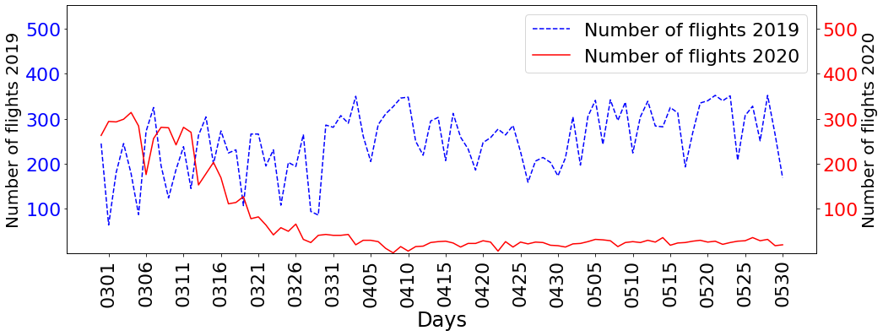
Number of Arrival Flights

Slide 7
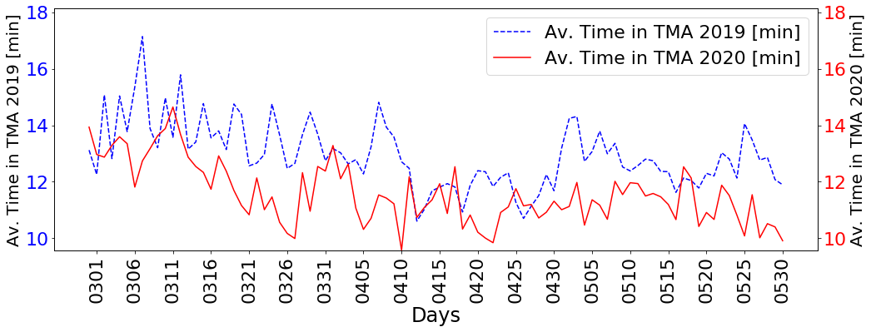
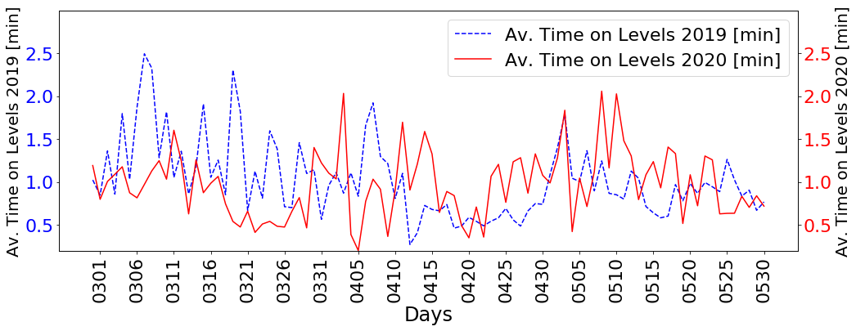
PIs in 2019 and 2020
Time in TMA vs traffic intensity:
R²_{adj} = 0.43
Time flown level vs traffic intensity:
R²_{adj} = 0.11

Slide 8
Weather Metrics
Cloud base height
Low cloud cover
Wind gust
Convective Available Potential Energy (CAPE)
ECMWF ERA5 Reanalysis Dataset
horizontal resolution of 0.25 ֯ between grid points => average within TMA
24 times per day

Slide 9
Aggregated Impact Factor (AIF)
Aggregated Impact Factor (AIF) is a unified condition metric, representing the time period weather and traffic situation [Lemetti et al., ICRAT'20]
To calculate AIF:
Choose the time period (we take one hour)
Choose impact factors (number of arrival flights, wind gust, CAPE, cloud base height, low cloud cover)
Sum up normalized impact factors (real values from 1 to 5)
Discretize the results (integer values from 1 to 15)

Slide 10
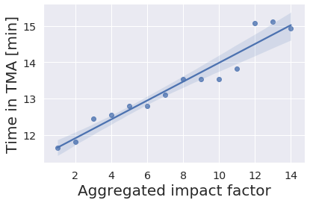
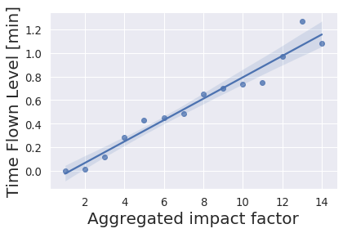
PI vs AIF
Regression of time flown level and additional time in TMA medians onto the AIF (R² = 0.94 and R² = 0.96)

Slide 11
Weather Impact Factor (WIF)
Weather Impact Factor (WIF) is a unified metric, representing the time period weather conditions
isolated scenario with low traffic flight performance
the same methodology as for AIF calculation, but without traffic intensity impact factor
Traffic Impact Factor (TIF)
Traffic Impact Factor (TIF) is a unified metric, representing the time period traffic situation
isolated scenario with good weather conditions
calculated by discretizing the traffic intensity

Slide 12
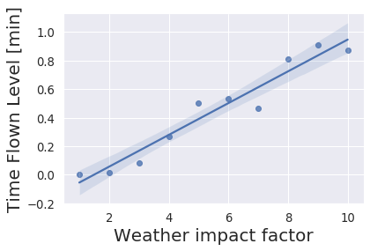
Isolated Scenario with Low Traffic
April-July 2020
Time Flown Level vs WIF: R²_{adj} = 0.94
Time in TMA vs WIF: R²_{adj} = 0.62

Slide 13
Isolated Scenario with Good Weather Conditions
Cloud base height ≥ 200 feet
Low cloud cover < 1
Wind gust ≤ 25 knots
Convective Available Potential Energy ≤ 150 J/kg
M. Taszarek, S. Kendzierski, and N. Pilguj, “Hazardous weather affecting European airports: Climatological estimates of situations with limited visibility, thunderstorm, low-level wind shear and snowfall from ERA5,” Weather and Climate Extremes, vol. 28, article 100243, 2020.

Slide 14
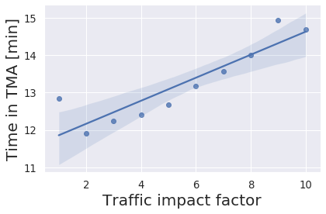
Isolated Scenario with Good Weather Conditions (cont.)
Time in TMA vs TIF: R²_{adj} = 0.81
Time Flown Level vs TIF: R²_{adj} = 0.47

Slide 15
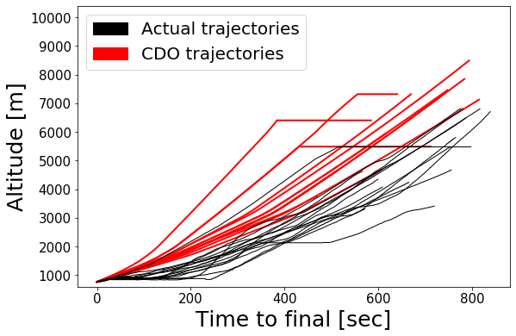
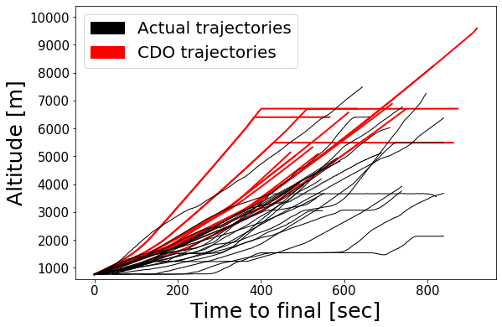
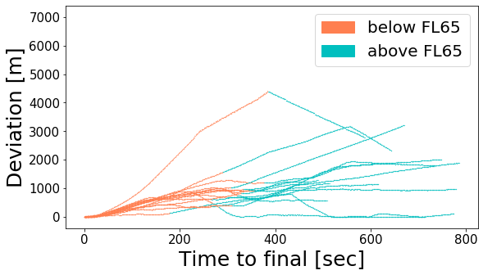
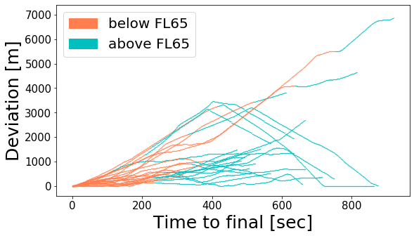
Vertical Profiles – 12.04.20 and 04.05.20

Slide 16
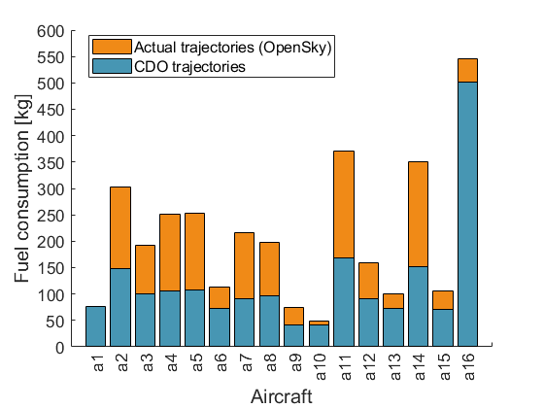
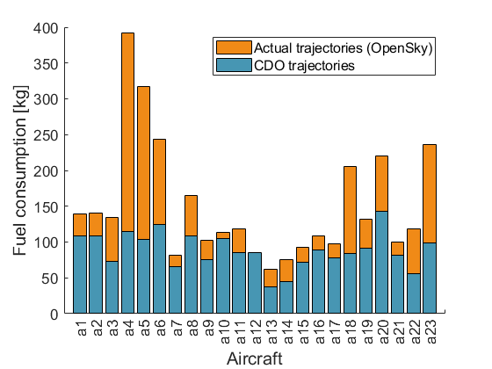
Fuel Burn – 12.04.20 and 04.05.20
1416 kgs (42%)
1444 kgs (41%)

Slide 17
Conclusions
Evaluated the performance of Stockholm Arlanda airport in an isolated scenario with low traffic
Revealed that the average time spent by aircraft in TMA has decreased compared to the pre-pandemic scenario
Vertical flight efficiency has not improved despite the low traffic volumes
Revealed a strong correlation of vertical flight efficiency with weather conditions
Vertical inefficiency in terms of extra fuel burn is up to 42%
Evaluated an isolated scenario with good weather conditions
Traffic intensity has a strong impact on TMA performance but influences mostly the lateral efficiency

Slide 18
Conclusions
Evaluated the performance of Stockholm Arlanda airport in an isolated scenario with low traffic
Revealed that the time spent by aircraft in TMA has decreased compared to the pre-pandemic scenario
Vertical flight efficiency has not improved despite the low traffic volumes
Revealed a strong correlation of vertical flight efficiency with weather conditions
Vertical inefficiency in terms of extra fuel burn is up to 42%
Evaluated an isolated scenario with good weather conditions
Traffic intensity has a strong impact on TMA performance but influences mostly the lateral efficiency
THANK YOU!

