Slide 1
Fine-grained Evaluation of Arrival Operations SIDs 2020 2020-12-07
Henrik Hardell Tatiana Polishchuk Lucie Smetanová

Slide 2
Introduction
2
Improving ATM efficiency is high on the agenda of aviation policy makers
Key Performance Indicators (KPIs) for objective evaluation
Adaptive KPIs, taking reality into account
Study the effects of different factors in isolated scenarios
Pinpoint inefficiencies
Adoption and enhancement of methodology proposed by EUROCONTROL EC
Data-driven analysis to explore the dynamics of the KPIs
Notes:
a new project description

Slide 3
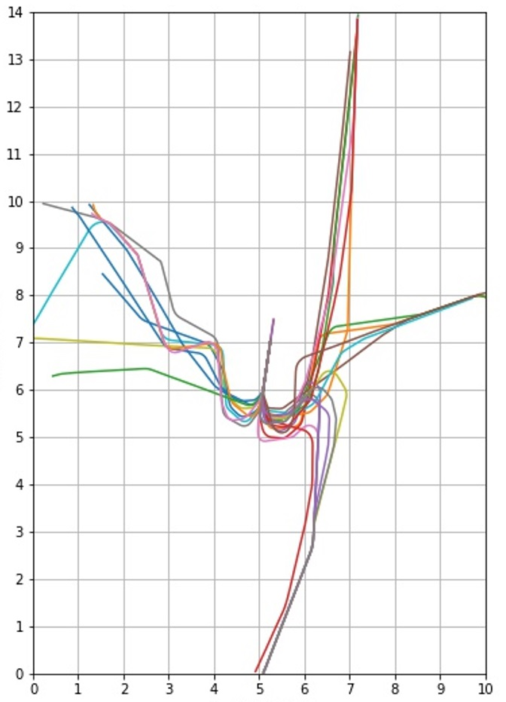
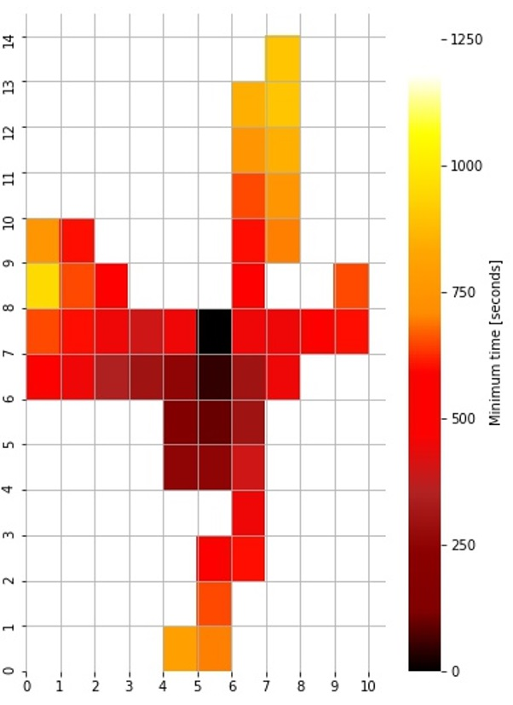
Selected KPIs
3
Minimum time to final
The minimum time it takes the aircraft to get from its current position to the final point
TMA represented by a square grid
Calculated for each cell of the grid
Notes:
a new project description

Slide 4
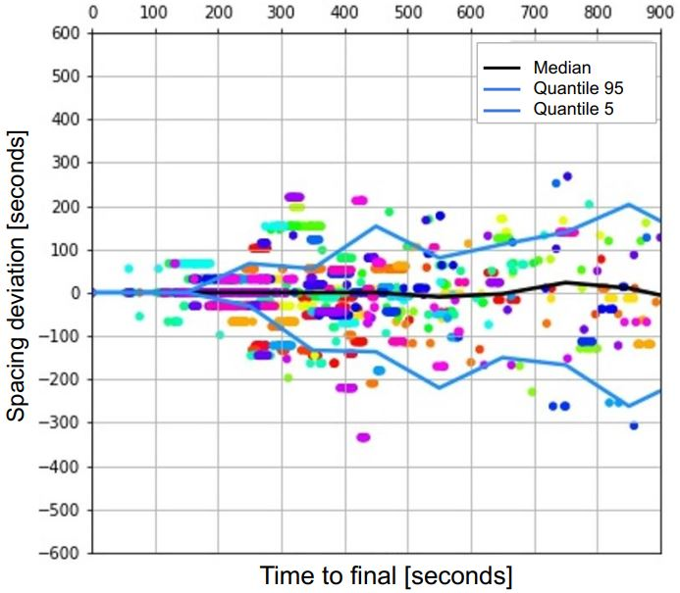
Selected KPIs
4
Spacing deviation
Defined for a pair of aircraft and the spacing between them at time t
The difference between the respective minimum times to final
Captures the aircraft’s mutual position in time
$$spacing deviation\left(t\right)=\min{time\left(trailer\left(t\right)\right)−\min{time(leader\left(t−s\right))}}$$
Notes:
a new project description

Slide 5
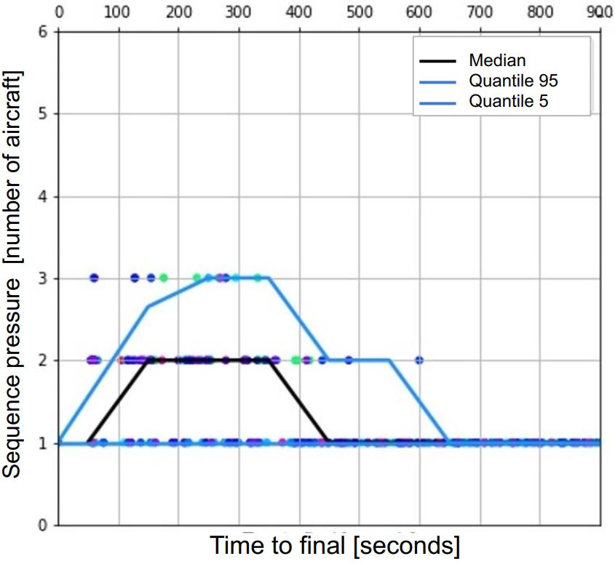
Selected KPIs
5
Sequence pressure
The number of aircraft sharing the same minimum time to final in a given time window
An indicator for measuring the aircraft density in the sequence pressure
Notes:
a new project description

Slide 6
Dataset
6
OpenSky Networks historical database
Opensky data allows exact determination of when aircraft enters TMA and when it reaches the final approach
Data is cleaned, smoothed and filtered, leaving only complete trajectories, from TMA entry to landing
Access to data for all aircraft arrivals to Stockholm Arlanda airport for the year 2018
We use subsets of the data corresponding to different time periods in 2018
Notes:
a new project description

Slide 7
Evaluation and data analysis
7
Use-case scenarios considered:
Night-time vs daytime operation
Scenarios with different traffic intensity
Scenario with heavy delays
Detecting the hotspots with potential separation violations
Notes:
a new project description

Slide 8
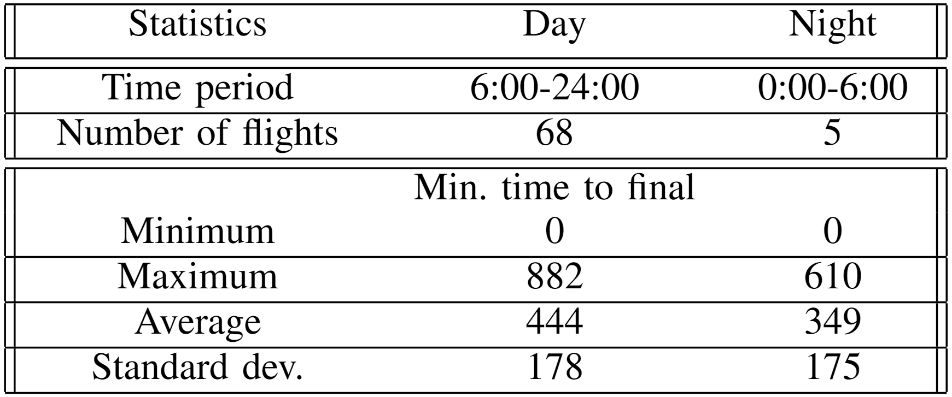
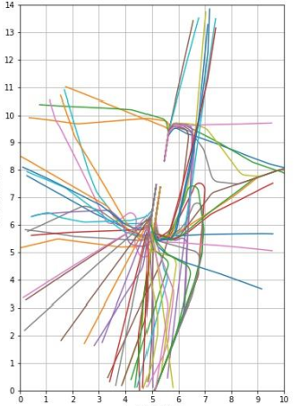
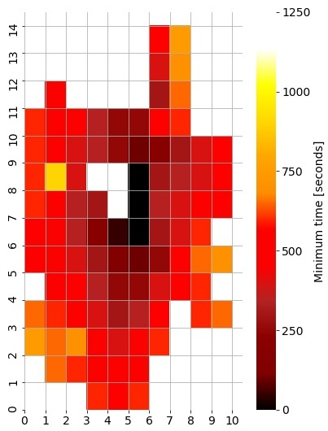
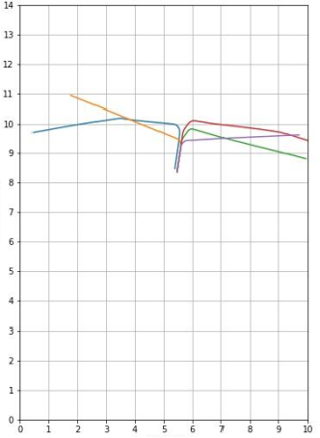
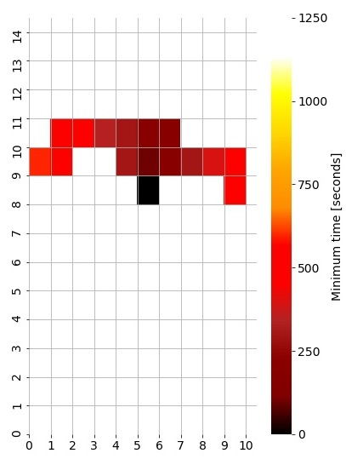
Night-time vs daytime operations
8
Minimum time to final
Daytime
Night-time
Notes:
a new project description

Slide 9
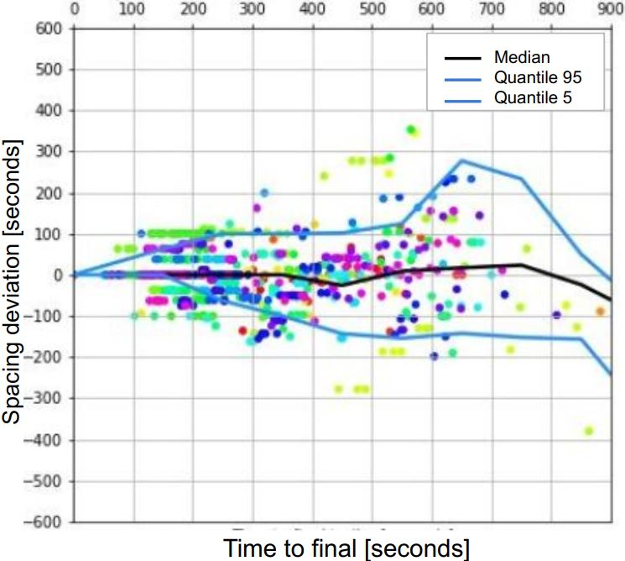
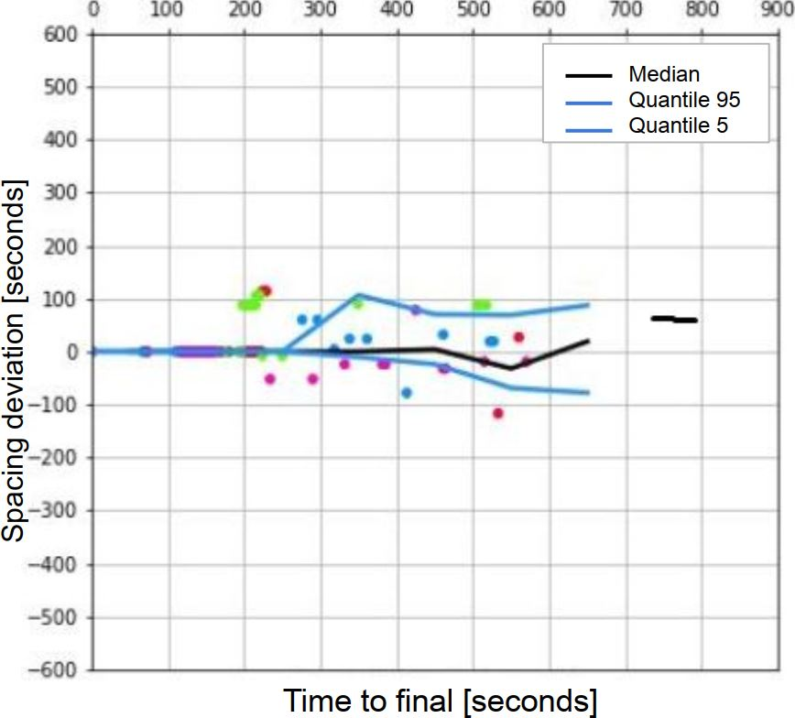
Night-time vs daytime operations
8
Spacing deviation
Daytime
Night-time
Notes:
a new project description

Slide 10
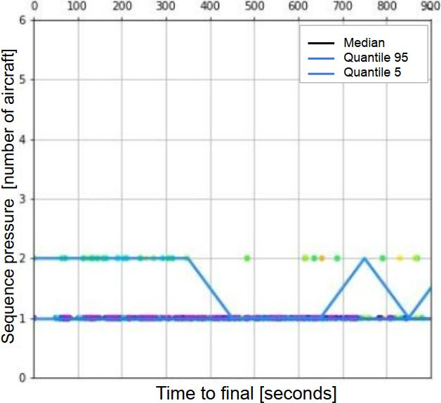
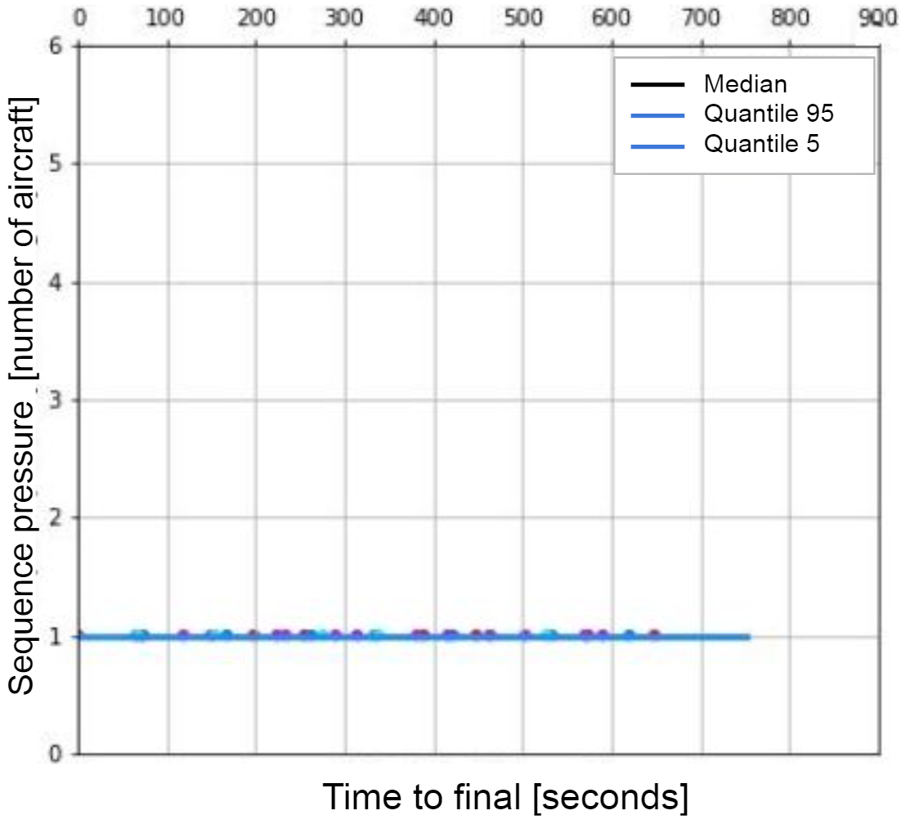
Night-time vs daytime operations
9
Sequence pressure
Daytime
Night-time
Notes:
a new project description

Slide 11
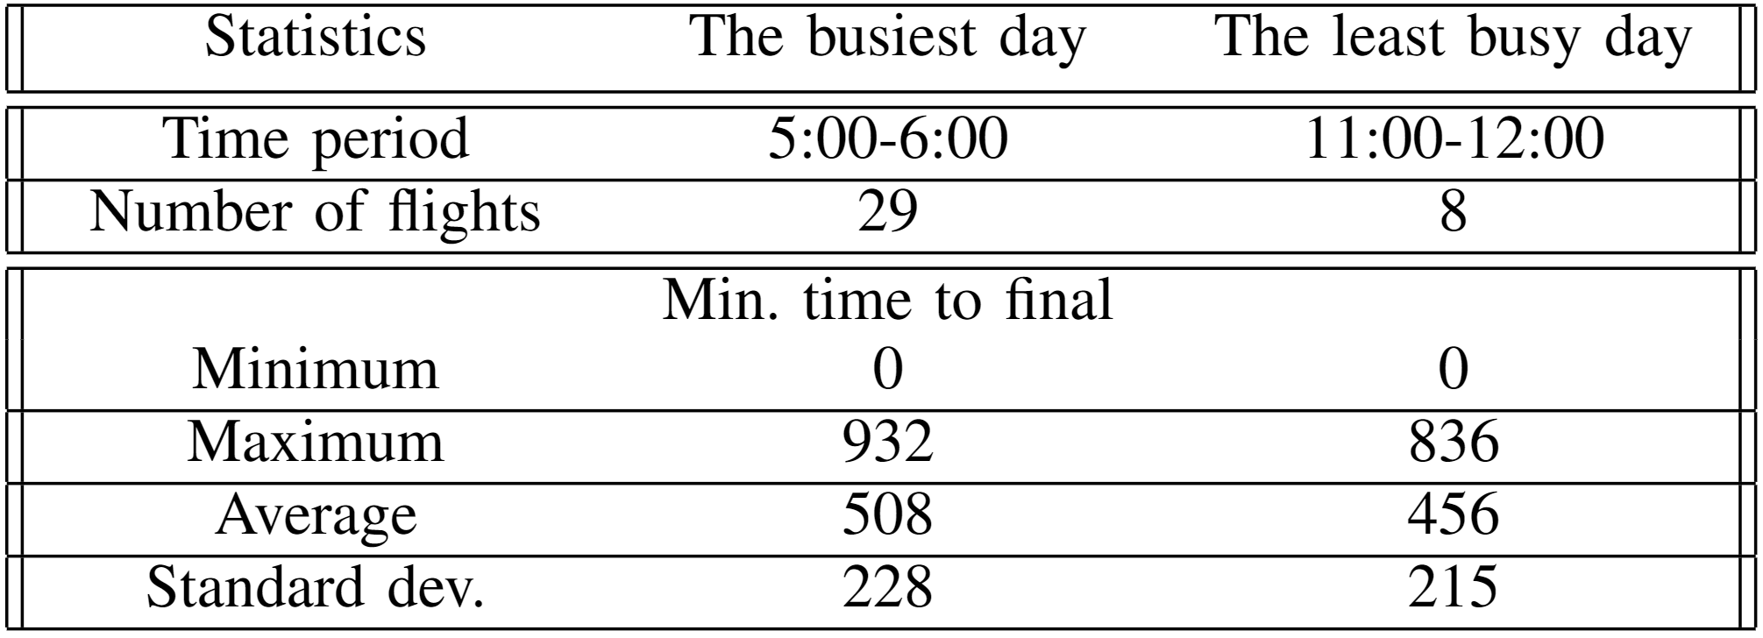
Scenarios with different traffic intensity
10
Minimum time to final
High-traffic hour
Low-traffic hour
Notes:
a new project description

Slide 12
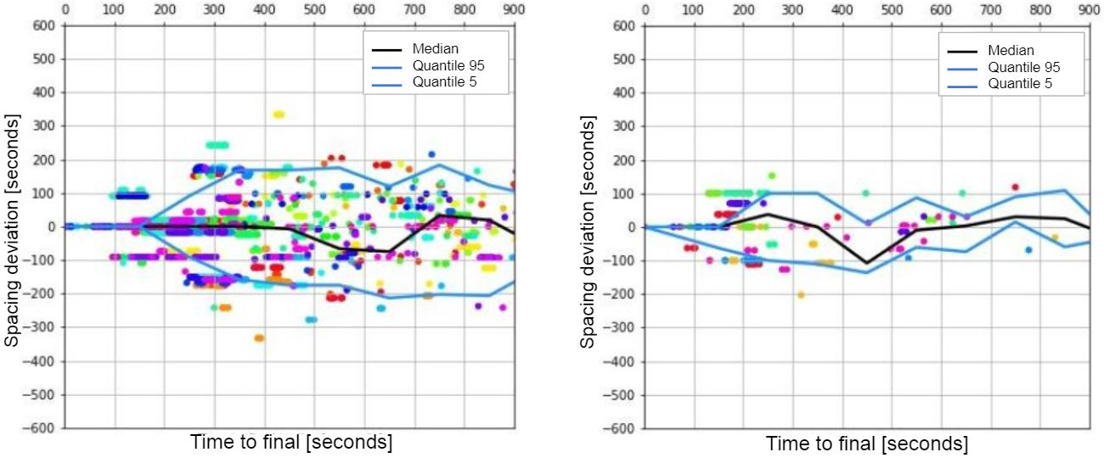
Scenarios with different traffic intensity
11
Spacing deviation
High-traffic hour
Low-traffic hour
Notes:
a new project description

Slide 13
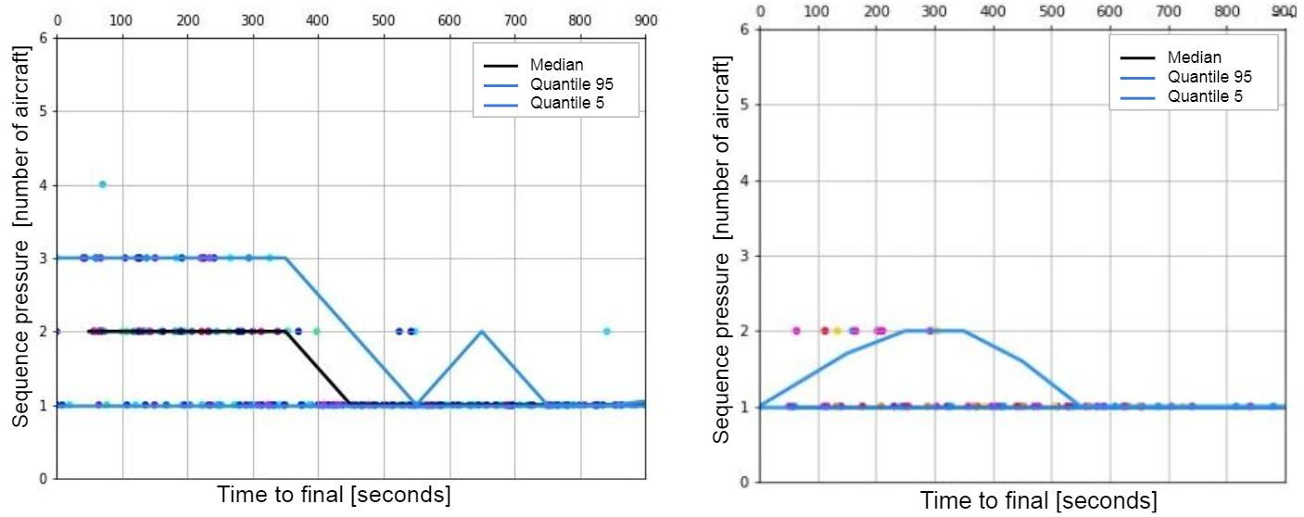
Scenario with different traffic intensity
12
Sequence pressure
High-traffic hour
Low-traffic hour
Notes:
a new project description

Slide 14
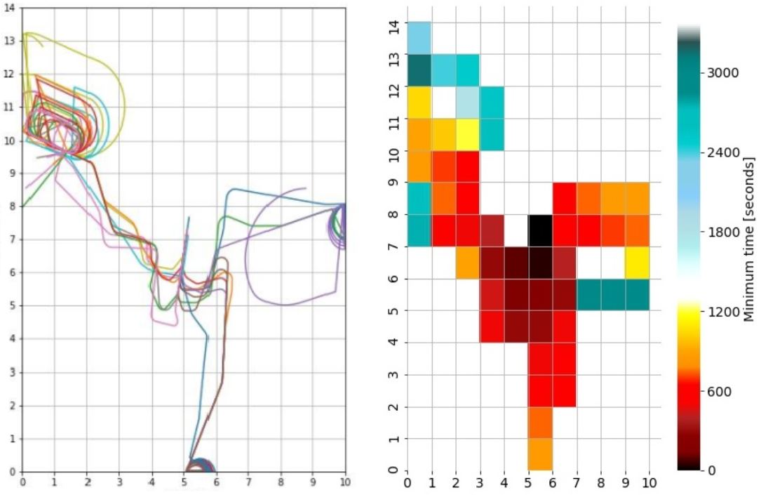
Scenario with heavy delays
13
Minimum time to final
Heavy delays due to severe snowfall on February 26
Notes:
a new project description

Slide 15
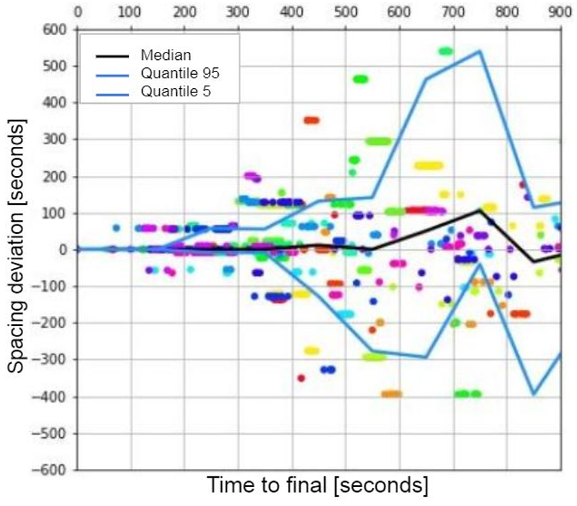
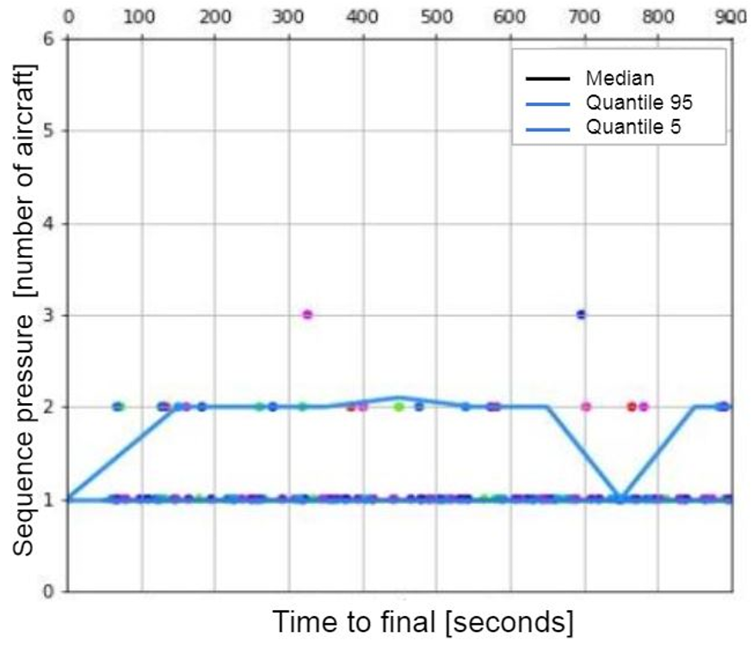
Scenario with heavy delays
14
Spacing deviation and sequence pressure
Heavy delays due to severe snowfall on February 26
Notes:
a new project description

Slide 16
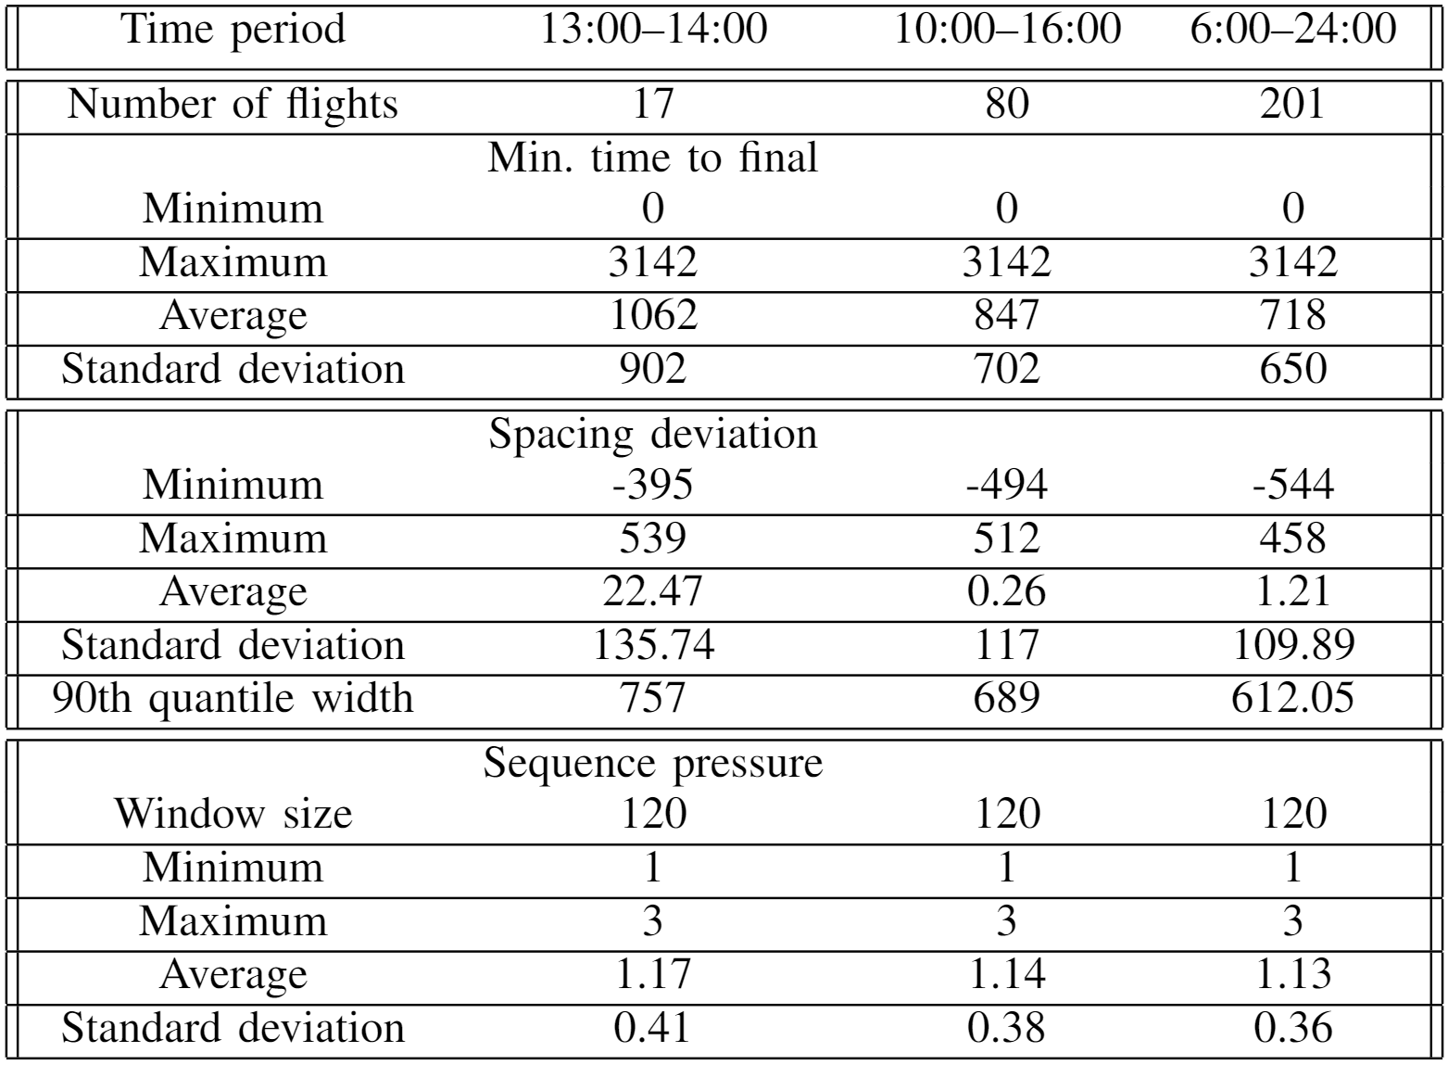
Study of KPI dynamics
15
Heavy delays due to severe snowfall on February 26
Notes:
a new project description

Slide 17
Detecting the hotspots with potential separation violations
16
Orange and green a/c separated by 80 sec, and red and green separated by 159 sec
Purple and blue a/c have already landed. Yellow a/c is at a safe distance
Black and cyan a/c separated by 106 sec, and grey and black a/c separated by 93 sec
Notes:
a new project description

Slide 18
Conclusions and future work
17
Fine-grained comprehensive assessment of the TMA arrival performance
Sequence pressure KPI helps to capture the cases of the potential separation violations
The KPIs can be used to uncover inefficiencies in TMA, allowing the aviation authorities to pinpoint areas where efficiency is lost and suggest directions for the improvements
Contribution towards the development of multidimensional adaptive KPIs, which will enable creating a comprehensive picture of the operations and faithfully characterizing ATM performance
Our future work will target the development of new such KPIs capturing other aspects of the TMA performance, as well as testing their applicability for evaluation of the optimization activities within TMA
Notes:
a new project description

Slide 19
Thank you!
Notes:
a new project description

