Slide 1
WADS 2011
2.CLOSED
1.CONVEX
Shang Yang
Stony Brook Univ.
08/17/2011
3.STABS EVERY ELEMENT

Slide 2
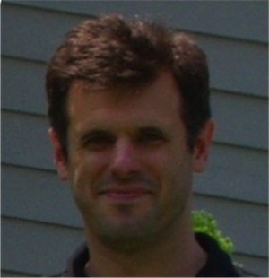
1.CONVEX
2.CLOSED
Joseph S.B.
Mitchell
Christian Knauer
Esther
M.Arkin
Claudia
Dieckmann
Valentin Polishchuk
Shang
Yang
Lena
Schlipf
3.STABS EVERYONE

Slide 3
Computing a convex transversal
1987:
original problem
proposed
Arik Tamir (NYU CG Day 3/13)
1990:
2d parallel segments
solved
Goodrich & Snoeyink*
* Comp. Vision, Graphics & Image Processing 49(2):152170

Slide 4
Motivation
Curve Reconstruction
Line Simplification
Motion Planning
Surface Reconstruction

Slide 5
Our contributions
2d segments,
squares,
3d balls
proved NP-hard
from 3-SAT
?
Disjoint segments,
pseudodisks
Polytime (DP)
If vertices are
from a given set

Slide 6
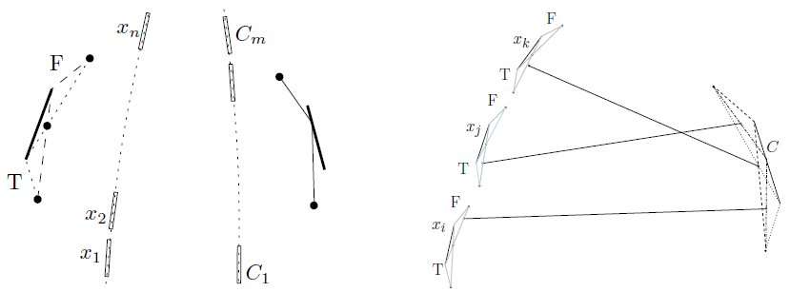
NP-Completeness Proof: Stabbing Arbitrary Segments
From 3-SAT

Slide 7
NP-Completeness Proof: Stabbing Arbitrary Segments
From 3-SAT :
A Variable Gadget:
Variable Gadgets
d
c
b
a
e
A Clause Gadget:
a
b
Clause Gadgets
c

Slide 8
From 3-SAT :
A Variable Gadget:
Variable Gadgets
d
c
b
a
e
A Clause Gadget:
a
b
Clause Gadgets
c

Slide 9
From 3-SAT :
A Variable Gadget:
Variable Gadgets
d
c
b
a
e
inner
Clause Gadgets

Slide 10
From 3-SAT :
A Variable Gadget:
Variable Gadgets
d
c
b
a
e
inner
Clause Gadgets

Slide 11
From 3-SAT :
A Variable Gadget:
Variable Gadgets
d
c
b
a
e
inner
Clause Gadgets

Slide 12
From 3-SAT :
A Variable Gadget:
Variable Gadgets
d
c
b
a
e
inner
e
f
Clause Gadgets

Slide 13
From 3-SAT :
A Variable Gadget:
Variable Gadgets
d
c
b
a
e
inner
e
f
Clause Gadgets

Slide 14
From 3-SAT :
A Variable Gadget:
Variable Gadgets
x_{i} is T
x_{i} is F
d
c
b
a
e
inner
e
f
x_{i} is T
x_{i} is F
Clause Gadgets

Slide 15
From 3-SAT :
A Variable Gadget:
Variable Gadgets
x_{i} is T
x_{i} is F
d
c
b
a
e
inner
e
f
x_{i} is T
x_{i} is F
Clause Gadgets

Slide 16
From 3-SAT :
A Clause Gadget:
Variable Gadgets
inner
a
b
c
Clause Gadgets

Slide 17
From 3-SAT :
A Clause Gadget:
Variable Gadgets
inner
a
b
d
e
f
c
Clause Gadgets

Slide 18
From 3-SAT :
A Clause Gadget:
Variable Gadgets
C_{i} = x₁ v ⌐x₂ v x₃
x₂ is T
inner
x₁ is F
x₃ is F
a
b
d
e
f
c
In a Variable Gadget,
x_{i} FALSE: the blue segments are not stabbed
x_{i} TRUE : the green segments are not stabbed
Clause Gadgets

Slide 19
A Clause Gadget:
Can stab any 2 (but not all 3) of segs d, e, f
a
b
a
e
b
d
f
d
e
f
c
c
a
b
a
b
d
e
f
f
d
e
c
c

Slide 20
C₁ = x₁ U ⌐x₂ U x₃
C₂= ⌐ x₁ U ⌐x₃ U x₄
F = C₁ ∩ C₂
x₁
x₂
x₃
x₄
Variable Gadgets
Clause Gadgets
C₁
C₂

Slide 21
Additional Hardness Results
Finding a convex transversal for:
a set of unit-length segments in 2D
a set of pairwise-disjoint segments in 3D
a set of disjoint balls in 3D
a set of disjoint unit balls in 3D Conjectured
is NP-Complete.

Slide 22
Polytime Algorithm: First Step
Segment
3-link chain:
Bridge
chord
Segment

Slide 23
Chords Are
NEVER
INTERSECTED
By Any Input
Segments

Slide 24
Chords & Bridges

Slide 25
A Bridge Partitions the problem
into 2 halves
B
B
p
q
p
q
Stab(pq, rt, B)=1
Stab(qp, tr, B)=1
Succeed!!
r
t
t
r

Slide 26
DP Current State (pq, rt, qabt)
q
p
c
a
a
b
b
r
t

Slide 27
DP Recursion( abc Case 1)
q
(c)
p
q
(c)
p
a
a
b
b
t
r
r
t
Stab(pq, rt, qabt)
= Stab(pq, rt,qbt)

Slide 28
DP Recursion( abc Case 2)
q
z
q
z
p
p
a
c
a
c
b
b
t
r
r
t
Stab(pq, rt, qabt)
=Stab(pz, rt,zcbt)

Slide 29
DP Recursion( abc Case 3)
q
z
q
z
p
p
a
c
a
c
b
b
t
r
r
t
Stab(pq, rt, qabt)
= Stab(pz, rt,zbt)

Slide 30
DP Recursion( abc Case 4)
q
p
a
c
c
u
Stab(pq, uz, qacz) & Stab(rt, vz, tbcz)
z
z
b
v
t
r

Slide 31
Base Case(1 & 2)
q
z
p
a
c
b
r
Stab(pq, rt, qabt) = FALSE
t

Slide 32
Base Case(3)
q
a
p
b
r
Stab(pq, rt, qabt) = TRUE
t

Slide 33
Review
B
B
p
q
r
t

Slide 34
Symmetry Detection
Stabbing with Regular Polygon
Polynomial Time Algorithm

Slide 35
Optimization Versions of the Problem
Maximize the number of objects stabbed by the convex transversal (DP)
Minimize the length of the stabber:
TSP with Neighborhoods (TSPN)
Require convexity: Shortest convex stabber
Example: TSPN for lines
Minimize movement of objects to make them have a convex stabber: optimal “Convexification”

Slide 36
Convexification
Fast 2-Approximation & PTAS

Slide 37
Convexification: 2-Approx
Let Q’ be the convex hull of Q, and let D be the maximum distance from a point, q, in Q to the boundary of Q’.
Q’
q
D

Slide 38
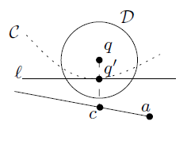
Convexification: 2-Approx
OPT
D

Slide 39
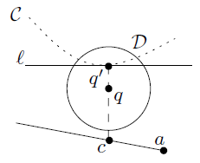
Convexification: 2-Approx
OPT
D

Slide 40
Summary
Settle the open problem in 2D:
Deciding existence of a convex transversal is NP-complete, in general
If objects S are disjoint, or form set of pseudodisks, then poly-time algorithm to decide, and to max # objects stabbed
3D: NP-complete, even for disjoint disks
Assumes candidate set P of corners of stabber is given.
Hard even for terrain stabbers!

Slide 41
3 Open Problems
Candidate Points NOT Given?
Allowing < k reflex vertices?
Fast 2d Unit Disk Case Solver?

Slide 42
Esther
M.Arkin
Christian Knauer
Joseph S.B.
Mitchell
Lena
Schlipf
Valentin
Polishchuk
Claudia
Dieckmann
Shang Yang
Thank you!
Questions Please!

