Slide 1
Remote Pilotage, Swedish Maritime Administration, DATS 2024
Anders Johannesson

Slide 2
The plan for this presentation:
A recap of maritime pilotage
Recap of what we have done in the two projects Navigational Support from Ashore (Remote Pilotage) 1 and 2
A couple of beautiful papers
Workload
An exhaustive list
Three simulations
Conclusions
What the conclusions can be used for
Next step

Slide 3
Recap of Maritime Pilotage. Why Pilot?
Local geographical knowledge
Expertice in ship handling and tugboat handling
Knowledge of port regulations and practices

Slide 4
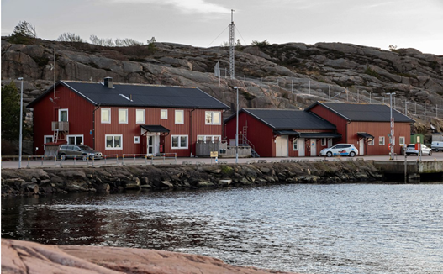
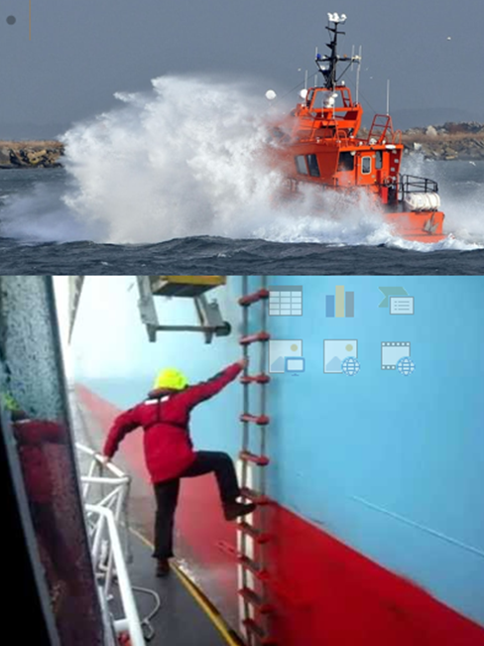
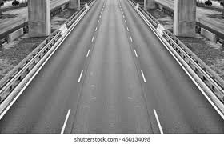
Why Remote Pilotage?
Ordinary Pilotage
PEC (Pilot Excemption Certificate)
NSA (Remote Pilotage)

Slide 5
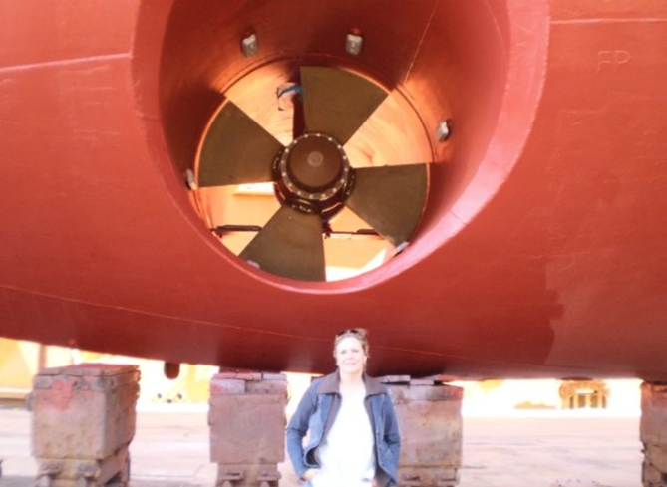
Suitable Vessels and well prepared crews

Slide 6
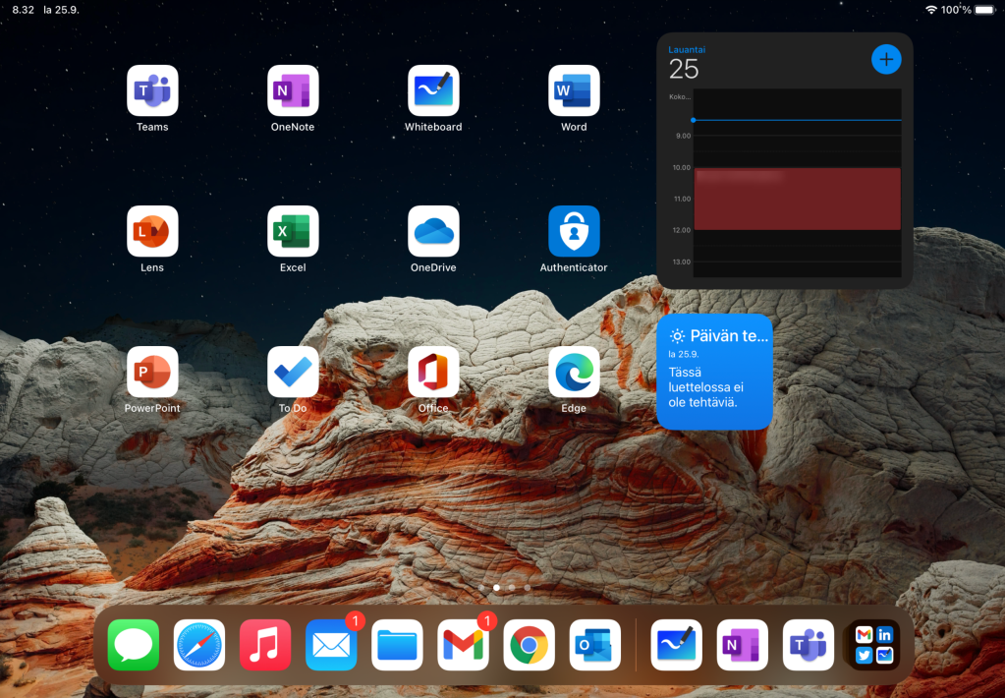
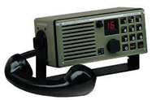
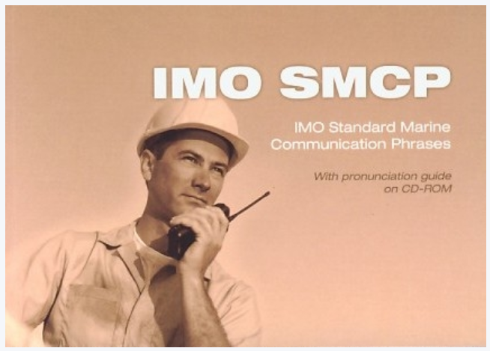
Two differences with our way of Remote Pilotage

Slide 7
”Remote Pilotage must be as safe as ordinary pilotage or even safer”

Slide 8
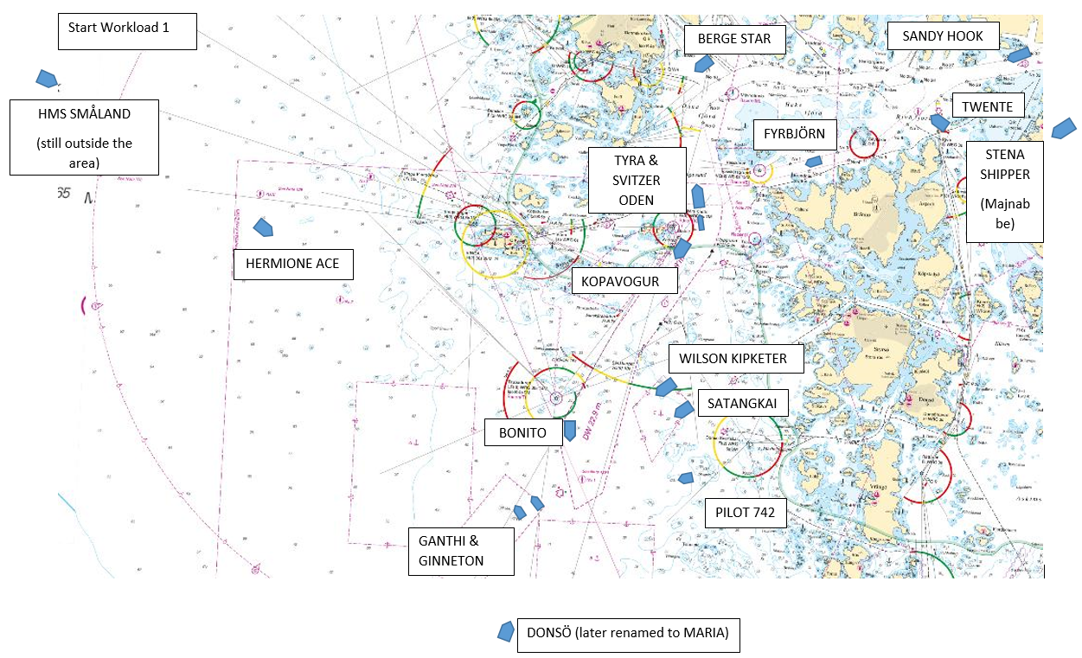
Workload, three rounds of simulations. First round.
March 24th 2023 – Could the same methods and sensors be used
in maritime remote pilotage context as
previously had been used research about
remote towers?
The Sensors - Video (capturing the NSA Pilot, his screens, all
communications etc.) Pulse Watch, Eye-tracking
glasses and EFT (Electronic Subjective Feedback
Collection Tool) and also Interviews
The scenarios - Two scenarios each 45 minutes long. Quite
demanding.
The results - Worked nice, we could see shifting levels of workload during the
scenarios

Slide 9
Second round, one NSA-pilot assisting two Vessels simultaneously. Inspired by Remote Tower workload research.

Slide 10
Second round, first simulation, an example

Slide 11
The NSA-pilot´s pupil diameter

Slide 12
Fixations

Slide 14
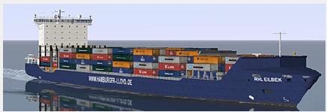
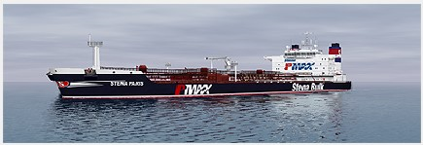

Slide 15
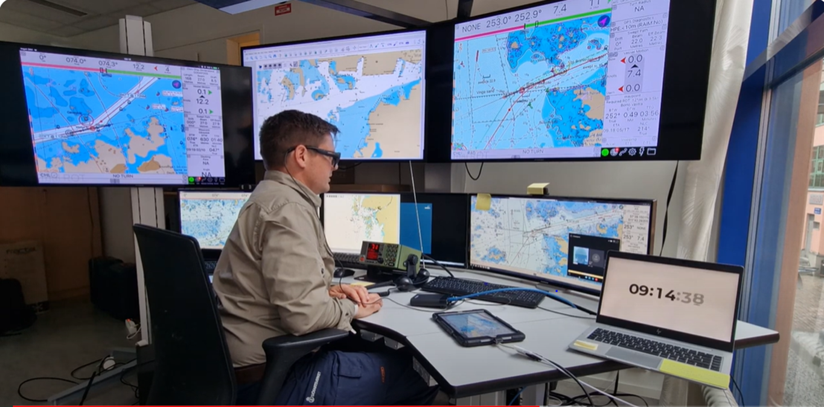
What is he thinking about?
DONSÖ TURN MEETING IRA HAYES
GODAFOSS CURRENT AND MEETING
IRA HAYES
BOTH VESSELS TURNING

Slide 16
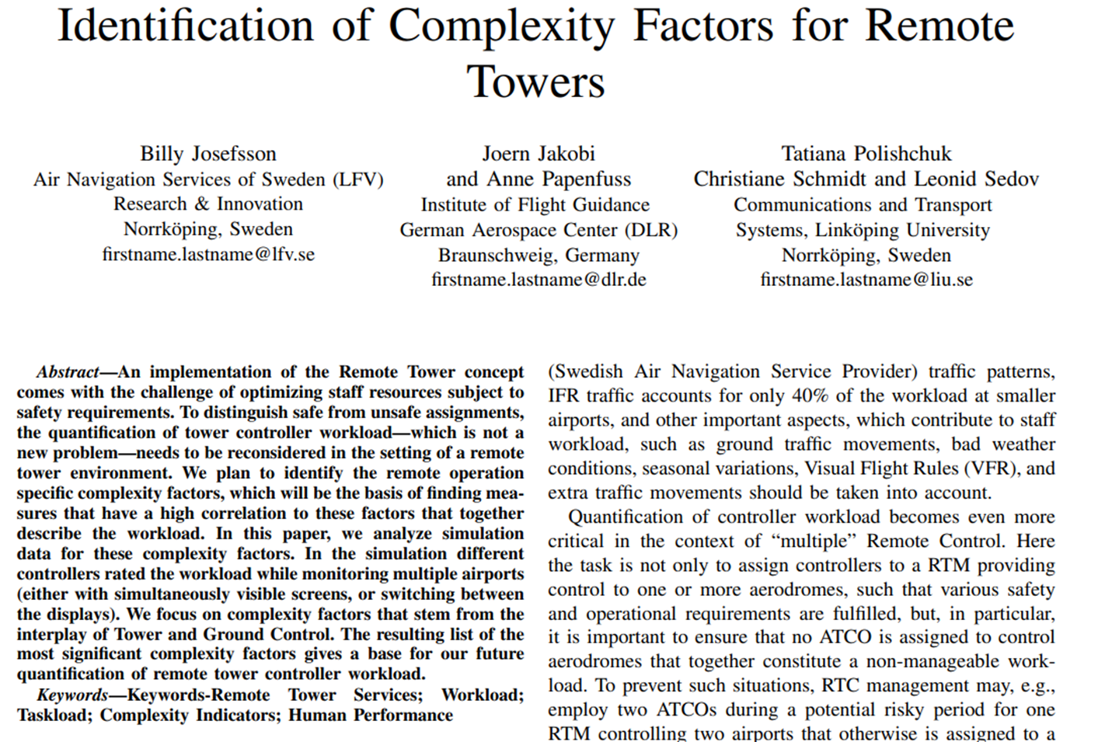
Great! Awesome! Super! ☺ But can we use this?

Slide 17
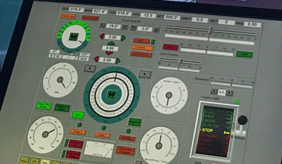
Pilotage
An exhaustive list:
Eight maritime pilots with NSA-pilotage experience from the simulator were asked to list the (in their opinion) biggest challenges with not being on board while piloting a vessel.
Quite a few bullets that could be sorted in to some five or six groups
I cannot see the conning display…

Slide 18
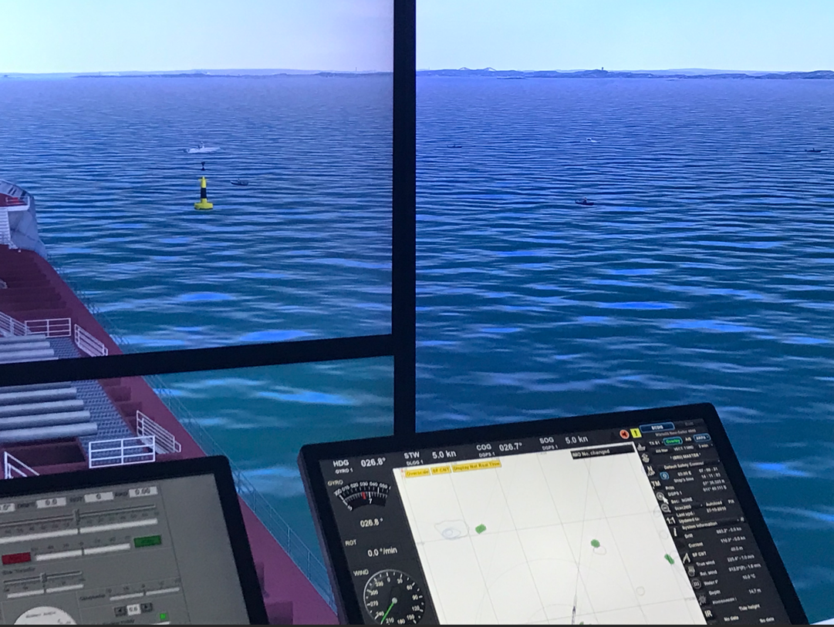
Nor can I see this…

Slide 19
Or this…

