Slide 1
And I cannot feel…

Slide 2
Back to the simulator. ”Normal” scenarios but every ten minutes something from the exhaustive list would happen.

Slide 3
Conclusions. After having scrutinized all material, the following list of workload driving phenomena was presented:
Things that the NSA-pilots consider most workload increasing/stressful/blood pressure rising are things that they cannot see themselves like small fishing boats, sailing boats, etc.
Second on the list was when the line of communication, ”the open line” was disconnected for some reason.
The third thing had more to do with interaction between human beings. Occasionally the pilot would get the answer ”yes, yes” from the ships´crews but at the same time he immediately got the feeling that the crew did not understand his instructions.
Heavy traffic.

Slide 4
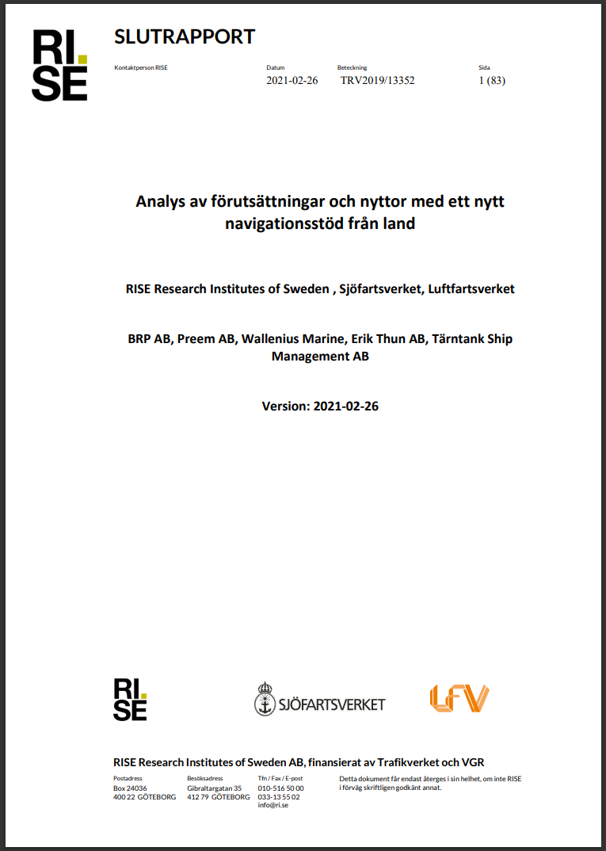
What can we use the results for?

Slide 5
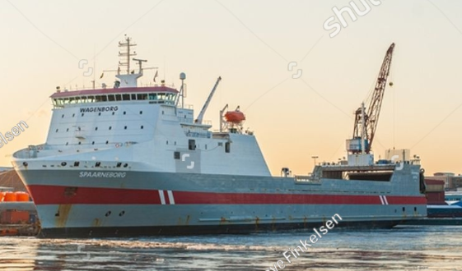
But let´s stick to our own list for a while. ☺ What to consider if we were to implement Remote Pilotage?
Preferably not where there are sportsmen. ☺
The areas in which the NSA-pilotage operations are to be done should have good 4G/5G coverage or other means for Internet connection.
Crews like these.
The traffic situation?

Slide 6
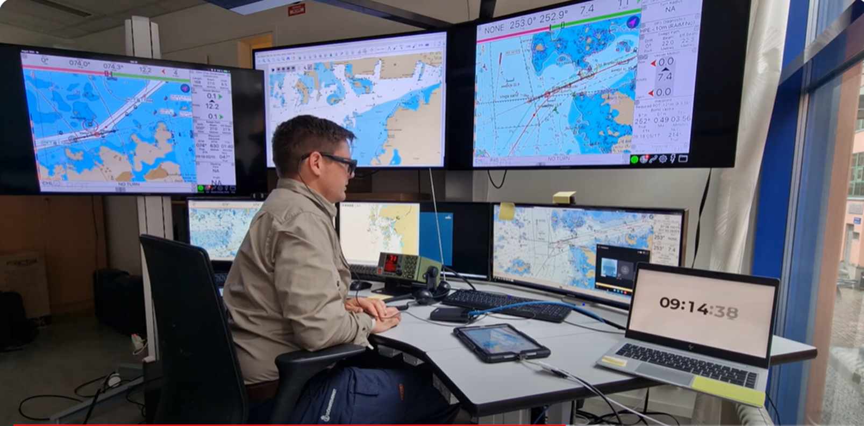
Next step
The ships´ crews rather than the NSA-pilot.
Real live testing with real ships and real crews.

Slide 7
That was pretty much it! ☺
Thanks for listening!
Any questions?

