Slide 1
Moving metrics: how to evaluate complex traffic scenarios
Michael Schultz, Simon Göppel
06th May 2024

Slide 2
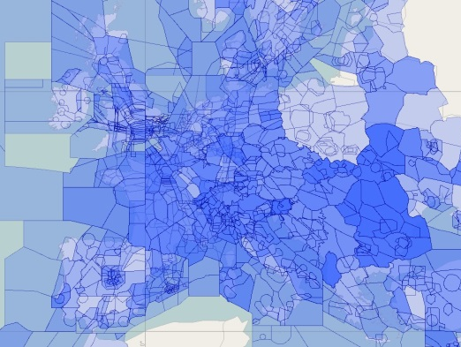
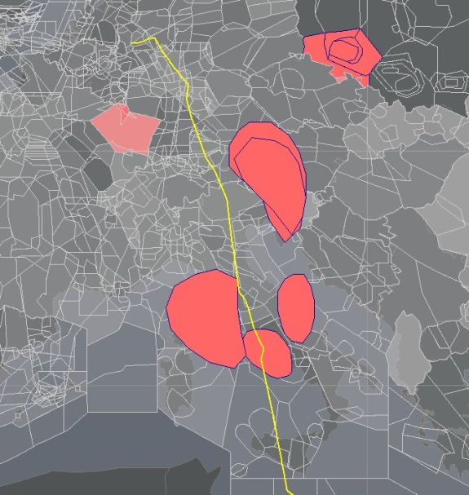
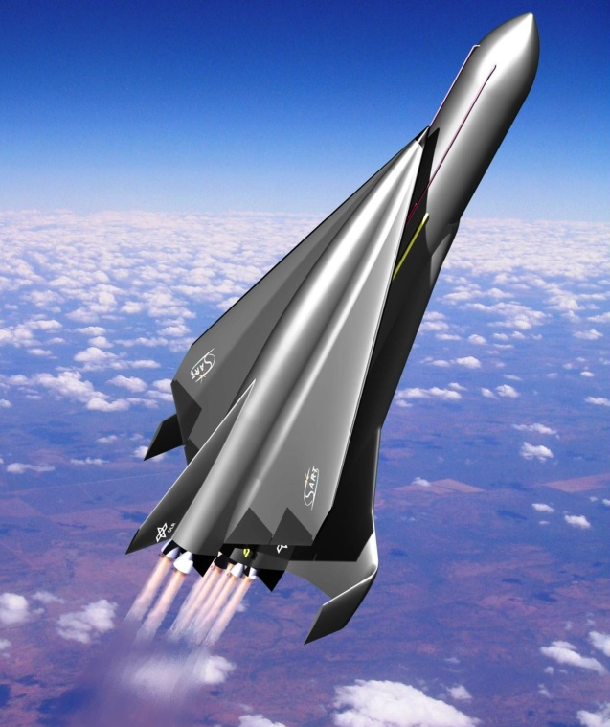
Airspace management
operations, complexity, new entrants

Slide 3
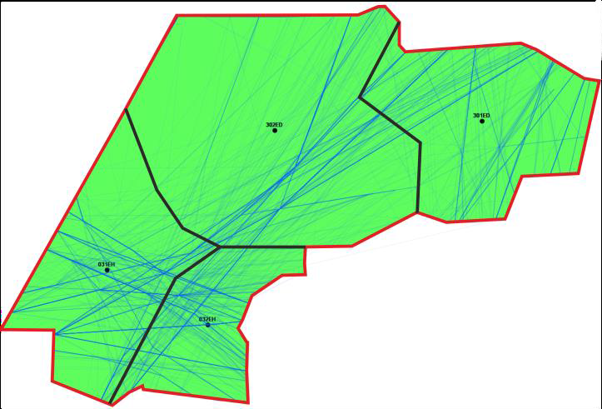
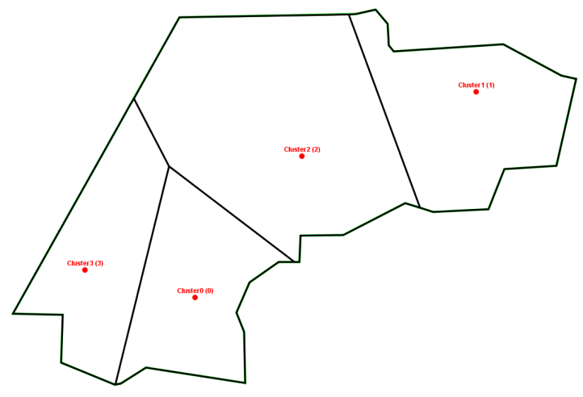
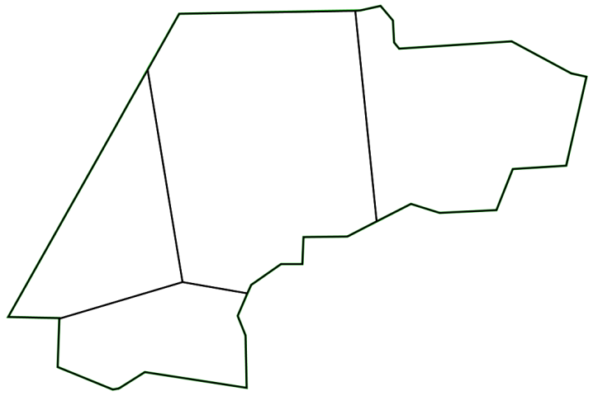
Airspace management
dynamic airspace structures
Dynamic Sectorization (2016 - 2020)
Traffic sample Center of movements Optimized structure

Slide 4
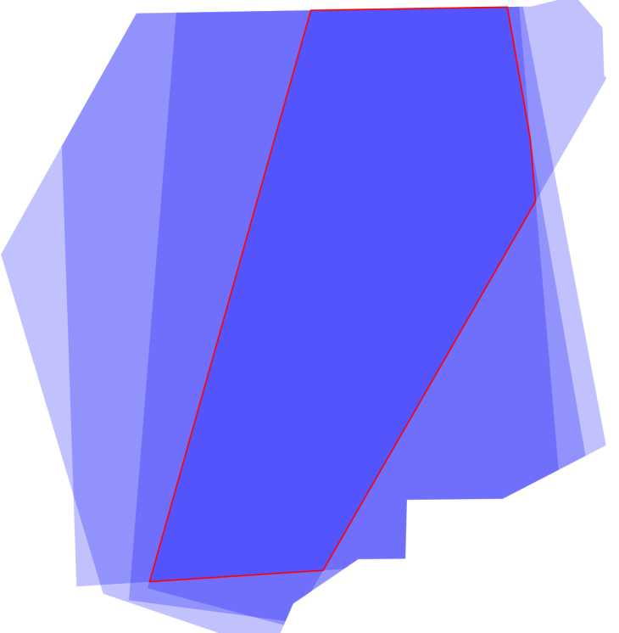
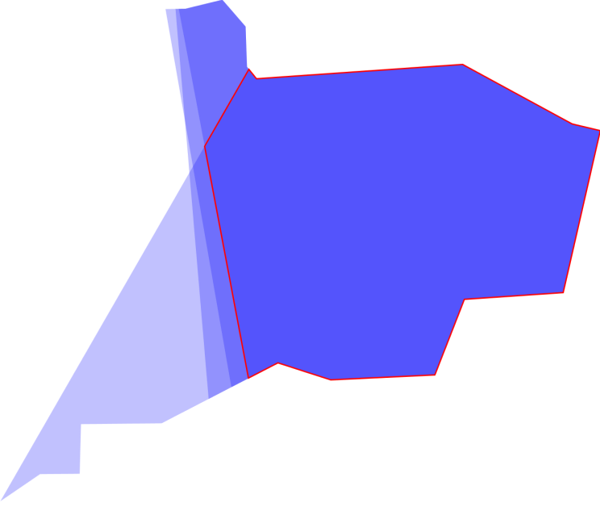
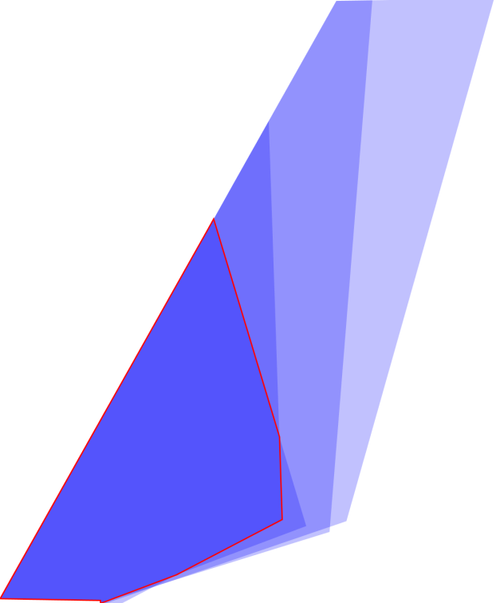
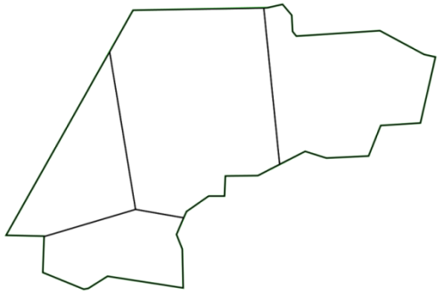
Airspace management
core areas of responsibility

Slide 5
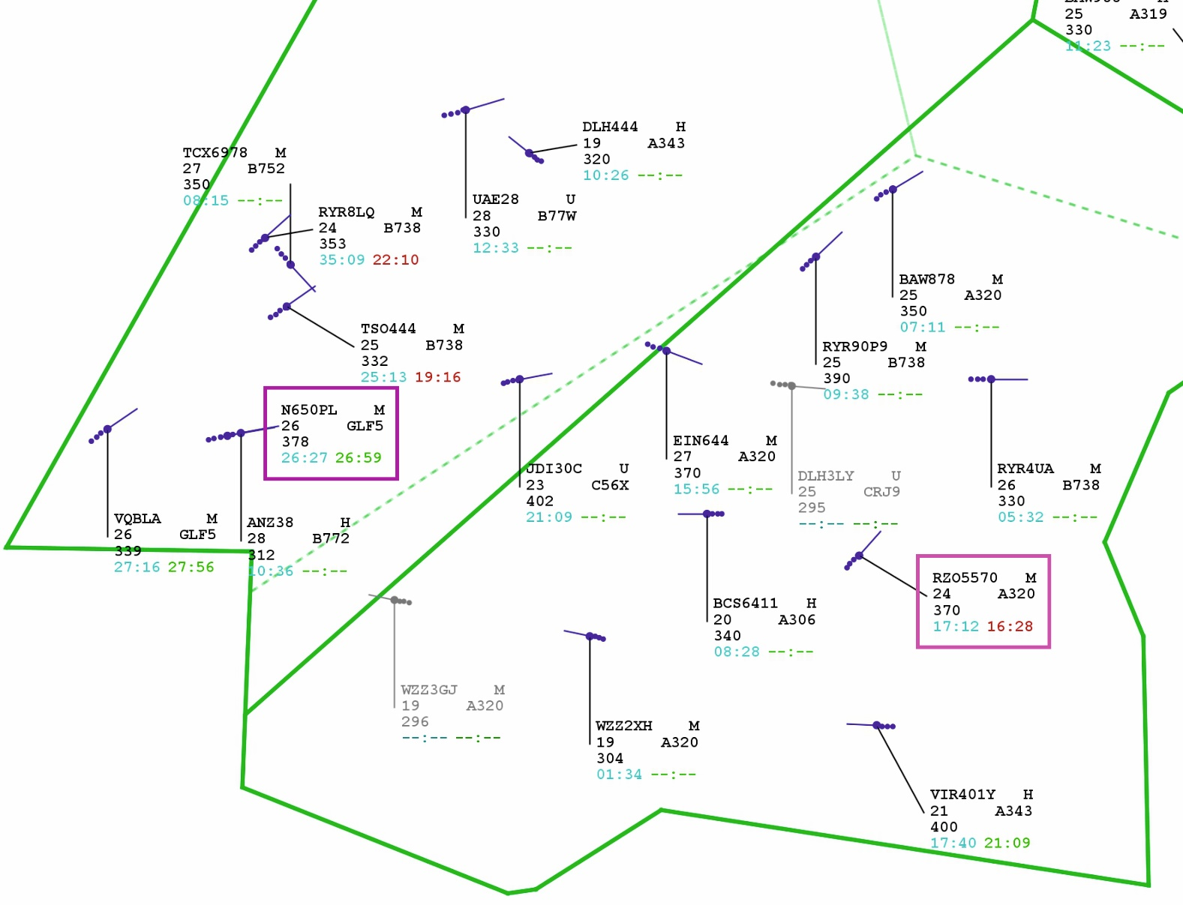
Airspace management
controller working position
Lesson learned
dynamic changes of control area are not easily accepted by controllers
adjusted handover times instead of shifting borders is acceptable

Slide 6
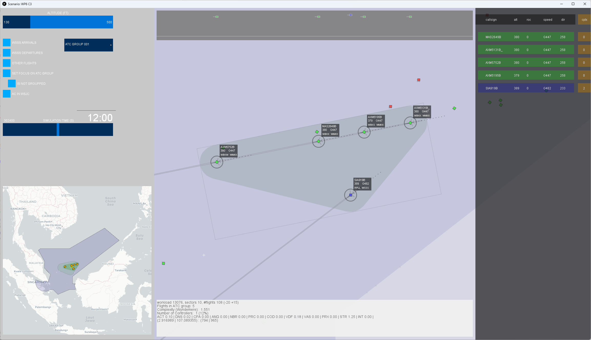
Airspace management
challenges
Complexity of the traffic scenario is a key driver for capacity and efficiency
Complexity serves as a proxy for determining the controller workload
Flow-centred management bundles similar flights to increase capacity
Moving sectors
consistent further development of dynamic sectorisation
key technology for future airspace management

Slide 7
Moving sectors (since 2022)
approach
How to build?
circular
tailored
How to implement?

Slide 8
Moving sectors
flow-centered alignment
Sector should be orientated in the direction of traffic flow (corridor)
Appropriate time and space to guide aircraft
Idea: rectangle with minimum width to cover this aspect (more or less)

Slide 9
Moving sectors
grouping of flights

Slide 10
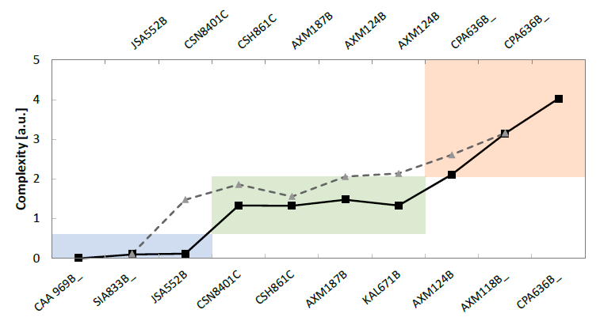
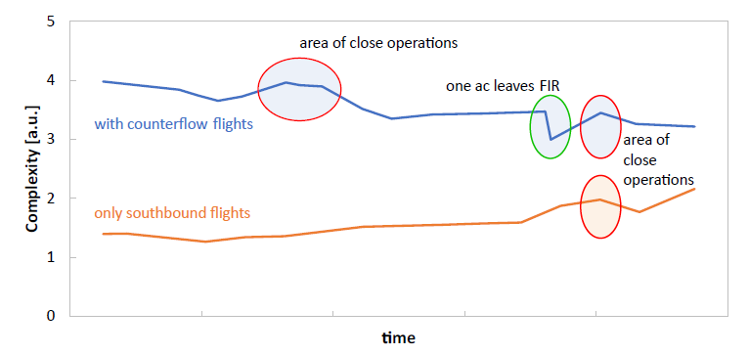
Moving sectors
grouping of flights

Slide 11
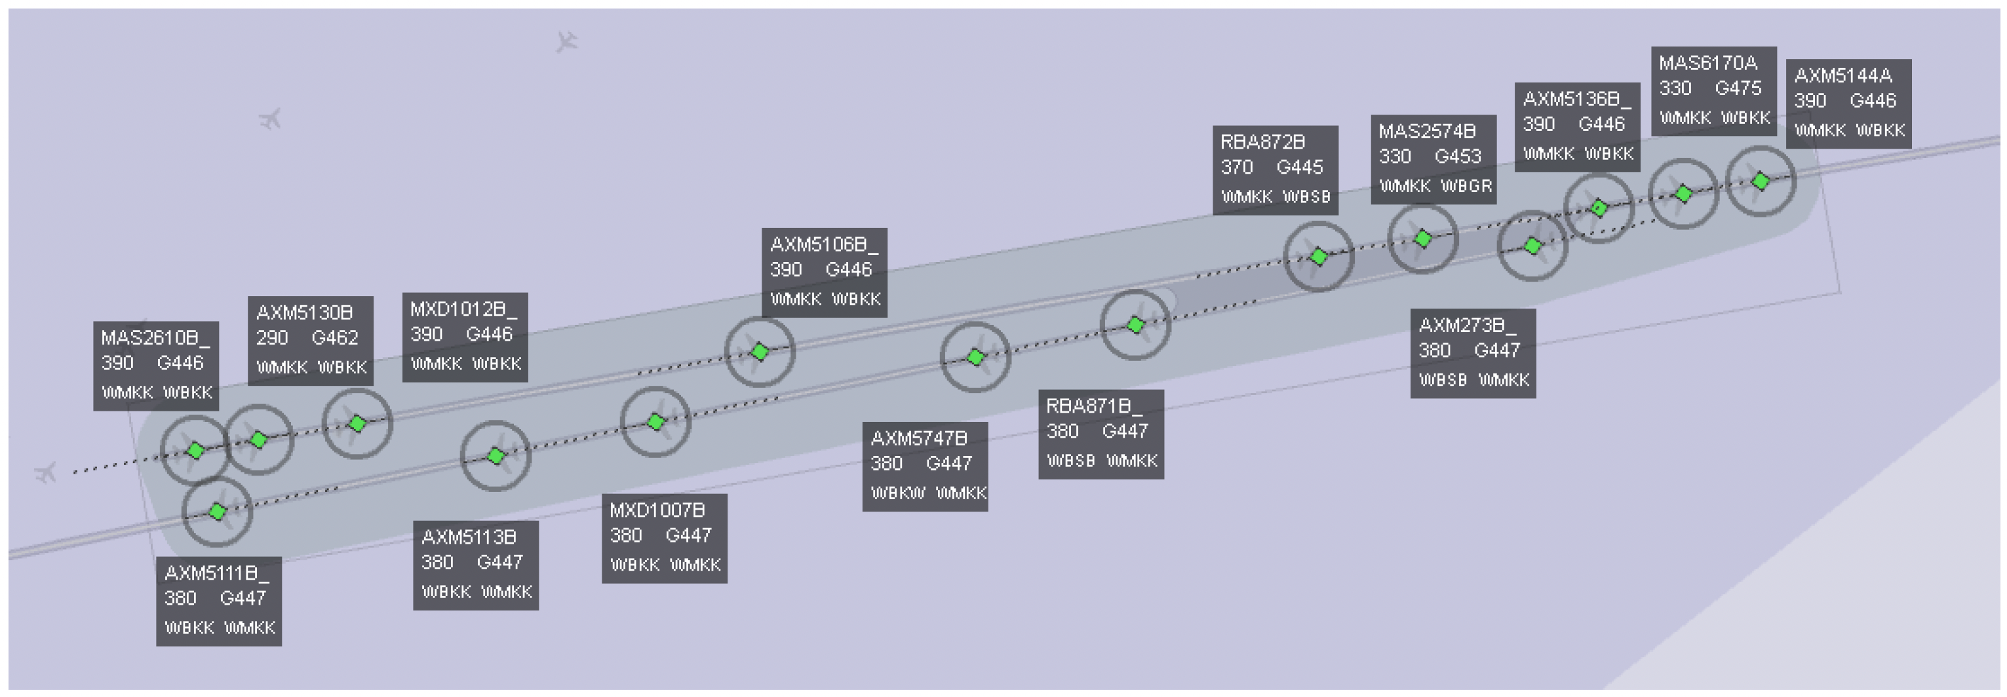
Moving sectors
Further adaptation of the complexity metric to the special features of moving sectors
Fundamental research necessary: many unanswered questions and an open field of research

Slide 12
Complexity
Notes:
We want to assess moving sectors by comparing them with conventional sectorization
For this assessment we would like to quantify the benefits from this now technology
Moreover, for an objective assessment, we need performance indicators
The main indicator we have for the air traffic system is airspace capacity.
Thats the reason we all invent new operational procedures, because we want to increas airspace capacity, right?
Whats the main limitation of airspace capacity? → atc resources
Namley, the air traffic controller and their workload limitations
Unfortunately, controller workload is a subjective measure
Dependant on individual properties, experience, resilience, and so on
So controller workload is not a proper performance indicator
But, there is a solution. Controller workload is linked to airspace complexity. Workload and complexity correlate.
A high airspace complexity indicate a high controller workload level and vice versa
And airspace complexity is calculateable using air traffic data.
Unfortunately, there is no common used set of complexity factors all ASNPs use to allocate their atc resources.
Additionally, the dynamic nature of moving sectors present a challenge to assess complexity using existing metrics
The experimental design to assess moving sectors follows a standardized approach:
first, establish a set of measurable factors;
second, generate representative traffic scenarios for air traffic controllers (ATCs) to interact with;
third, collect self-reported workload data at regular intervals; and finally,
use regression/correlation analysis to identify relationships between the predefined complexity factors and the collected workload data.

Slide 13
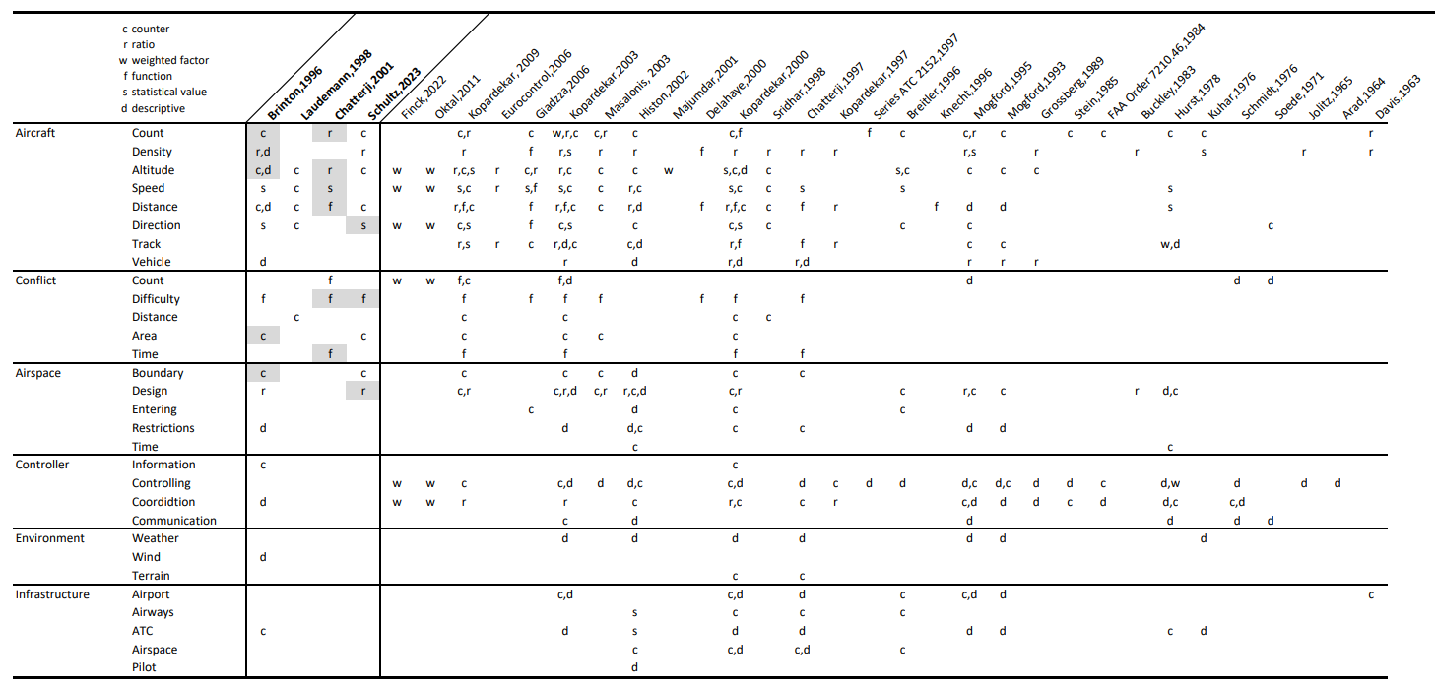
Air Traffic Complexity
literature

Slide 14
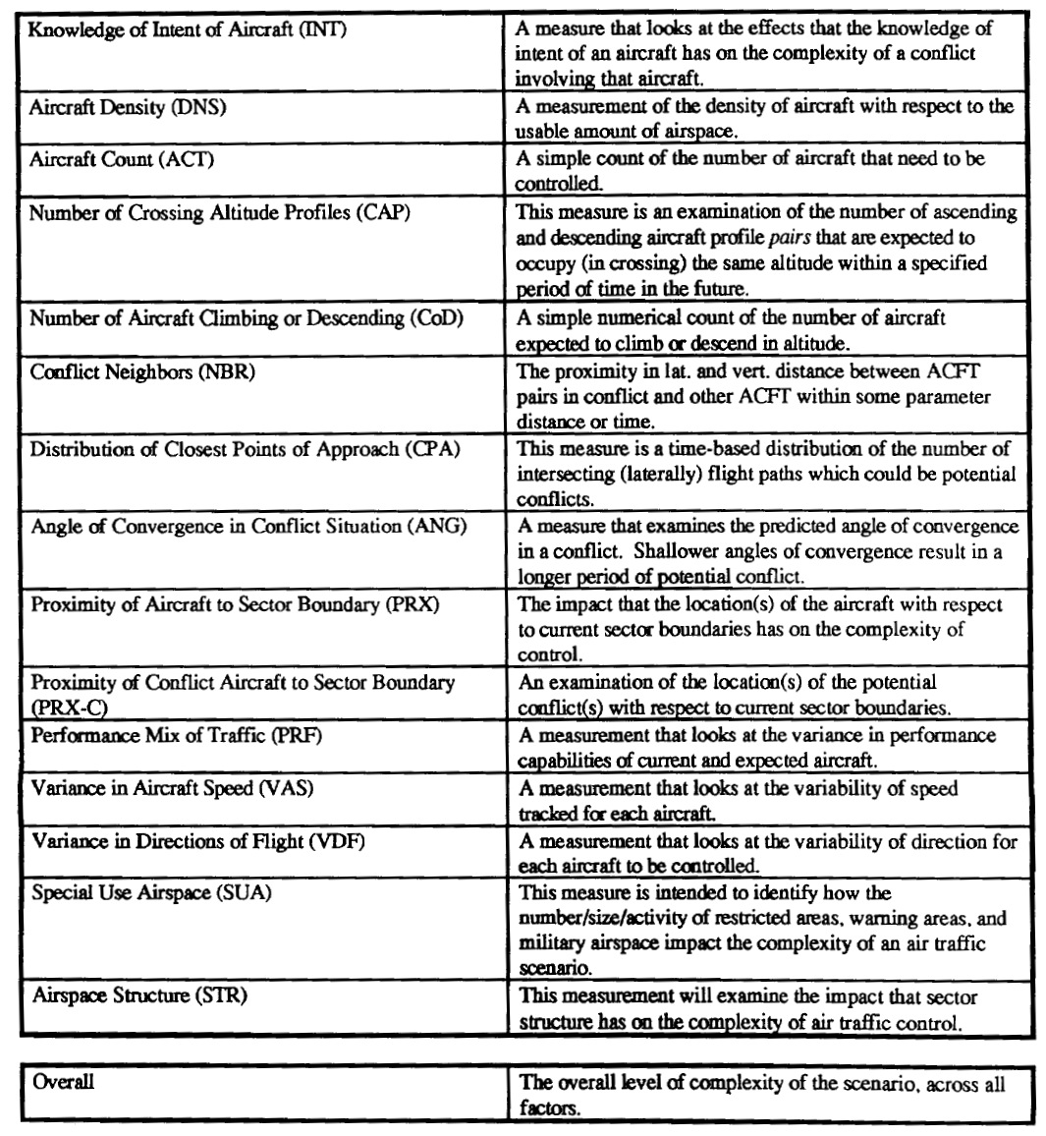
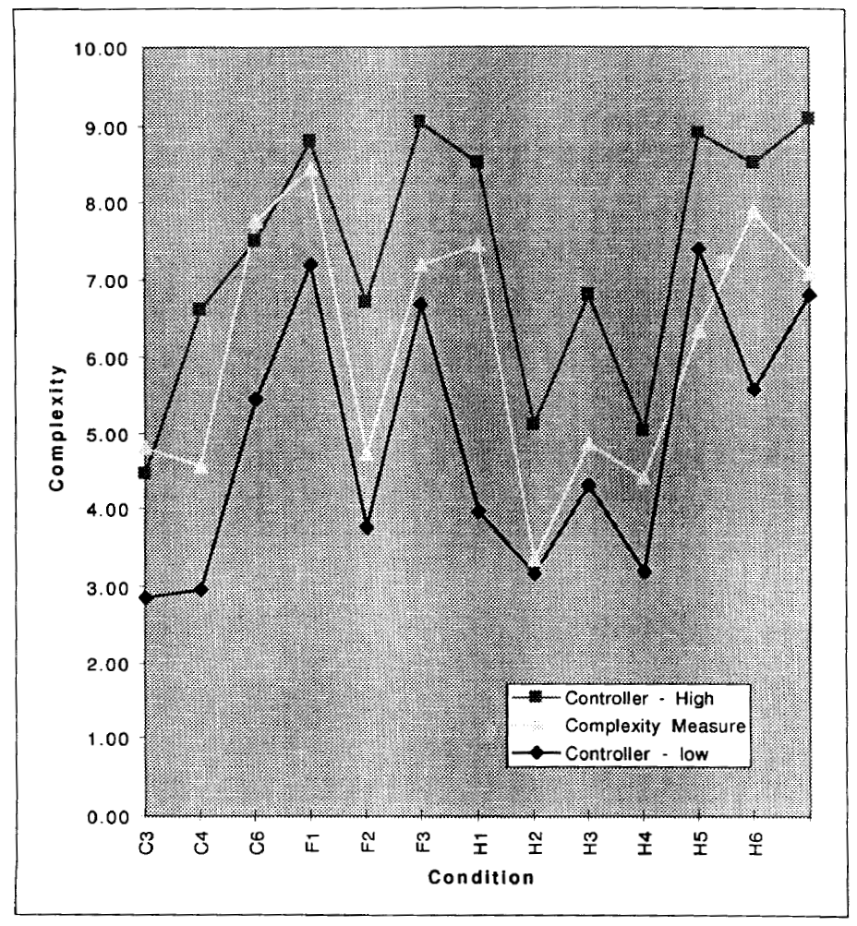
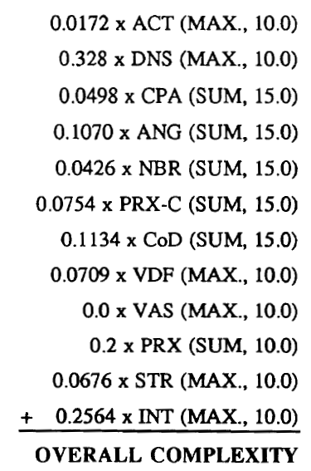
Air Traffic Complexity
quo vadis – re-search?
Open research, open data, cross-validation?
Brinton et al. (1996). An evaluation of air traffic control complexity
Notes:
The first study is from Brinton in 1996 and this is the best work we found on this topic.
They invented some factors
Unfortunately, without formulas, so these factors are not 100% defined.
But, they expained it well, so it is possible to formulated formulas for calculations
Besides, controller assessed air traffic scenarios and they compared the complexity calculation with the controller‘s assessment.
Based on this, they made an regression analysis to determine weights for their factros and formulated an overall complexity score as a weighted sum.

Slide 15
Evaluation Scenarios
Notes:
The next point is the generation of standardized scenarios for evaluation
We used realistic, simulated air traffic to create six distinct configurations (constellations) of moving sectors.
Later, these sector configurations will be used to derive standard cases for evaluation, which can then be used as reference cases in research.
This is one of my goals for this workshop
To derive standard air traffic scenarios for evaluation, everyone agrees with

Slide 16
Evaluation
Notes:
In the next step, we implemented the presented factos in our simulation environment and applied the metrics to the presented scenarios.
I have two examples here. Scenario 3 on top and 5 on the bottom.
In the top scenario there are two traffic flows
The upper one is flying to the right and the lower one is flying to the left.
Both flows cross each other on the right hand side
The scenario on the bottom has more flows
Two aircraft are flying down, two are flying to the left and two to the right
They cross each other in one point
Additionally, we made a survey and interviews air traffic controllers.
The controllers ware asked to rate the complexity of each scenario on a 5 point scale, reflecting their actual domain expertise
The rating was done for each scenario and for 3 different timesteps
We see the controller rating in these diagrams as grey bars.
The median of the ratings is indicated as red horizontal line with a red box, representing the 25% quartile and the 75% quartile
Moreover, the three complexity scores M1, M2, and M3 are shown as the blue, yellow, and green bar.
The orange line here is the average of these three scores.
What we can see is when we look at the controller ratings that there is a certain variance in the ratings. The bandwidth is more less the whole scale in the majority of times.
Whereas the complexity calculations are more aligned.
And what we can also see is that the calculations are in 4 from 6 times aligned with the ratings. Here the orange line is inside the red box.

Slide 17
Regression Analysis
Notes:
We see this good match of calculations and ratings also when we look at this graph
On the y-axis is the average of the complexity calculations
And on the x-axis is the median of the controller assessment
And we compare them now. Yes, I know this is not 100% clean to compare an average with a median.
But, we saw the variance in the ratings, therfore we chose to use the median to have less weight in the extremas
And we chose the avarage for the metrics, because there are just 3 and using the median, whould not make any sense
So, how to read this graph?
The controller assessments are from 1 to 4 and whenever the controllers rated a situation with a certain complexity. How high is the calculation?
The calculations are adapted to the scale and are the orange dots
And what we can see is, except one outliere we detected, is that the calculation and the ratings are well aligned with an R square of 78%
That means that 78% of the variance of the controller ratings can be explained with the complexity calculations
This results leads to the statement that the the chosen complexity metrics can be used to determine the complexity of moving sectors and moreover to assess and evaluate this technology.

Slide 18
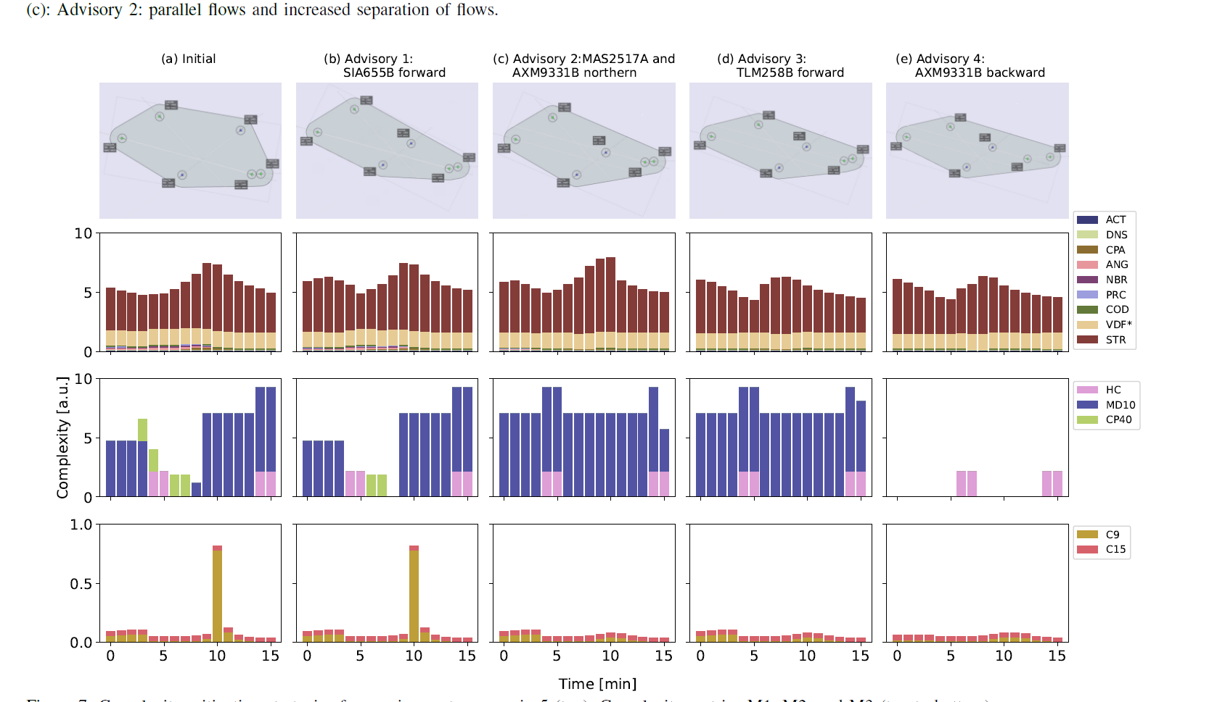
Solving Air Traffic Scenarios
Notes:
However, me made another form of evaluation and changed the scenarios in order to see how the metrics bahave.
We tried to uncompress the scenarios and equalize them
For example, here is one flow flying to the right and one flow flying to the left on one line. We moved the first a little bit to the north and the second a little bit to the south and so they are horizontally well separated from each other
The assumption would be that the complexity decreases with those actions
And we can actually see that in the calculations
In the first step we move this aircraft to cross the other flow earlier. And we see that changed more less nothing, CP40 decreased a little bit
Secondly, we moved those two aircraft to the north, in order to increase separation, as i explained before. We see that actually, C9 dropes significantly
In the third step, we moved this aircraft a little bit forward, which did not change anything
In the last stept we moved this aircraft a little bit backward, so that this aircraft is more separated from the one flying before and to cross the other flows later. We actually see a significant drop in complexity. Especially, in MD10
So overall, we can see that the metrics behave as assumed
And correlate with the controller ratings
So we came to the conclusion that they are suitable and can be applied to moving sectors.
Thank you very much!

Slide 19
Thank you.
Moving metrics: how to evaluate complex traffic scenarios
Univ.-Prof. Dr.-Ing. habil. Michael Schultz
michael.schultz@unibw.de
+49 (0) 89 6004 3040
https://www.unibw.de/lvk-en

