Slide 1
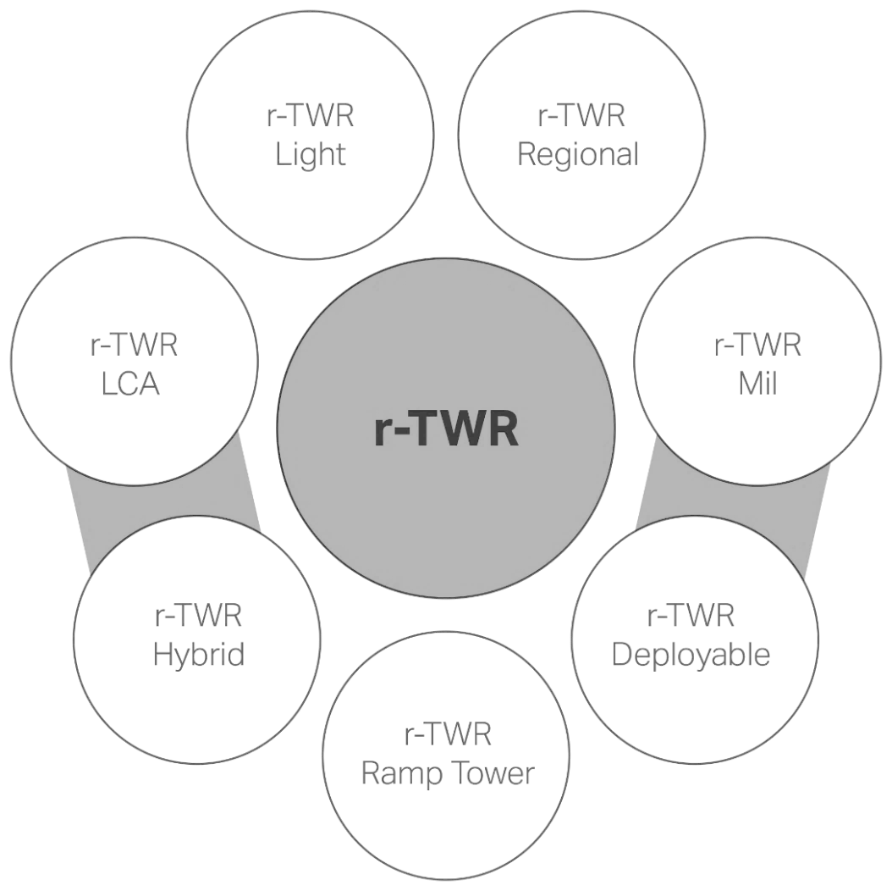
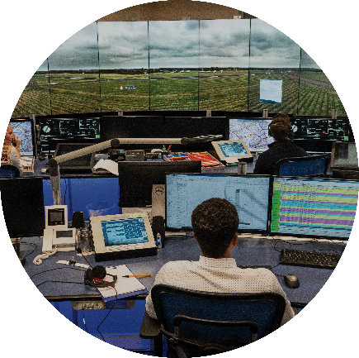
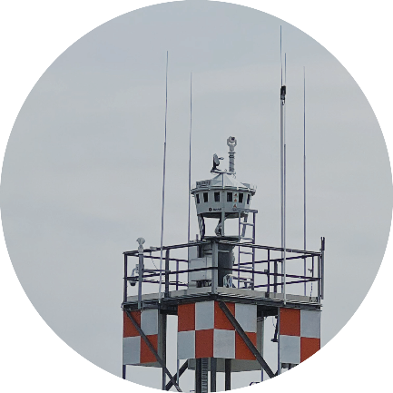
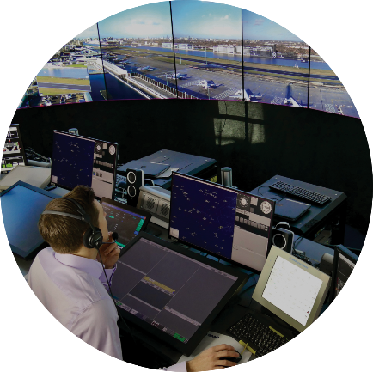
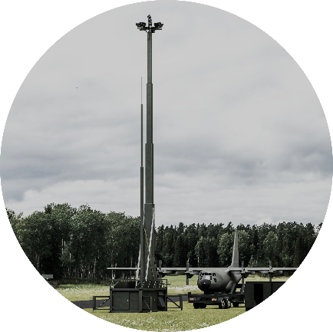
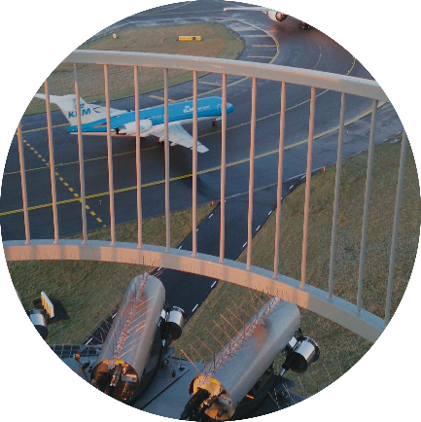
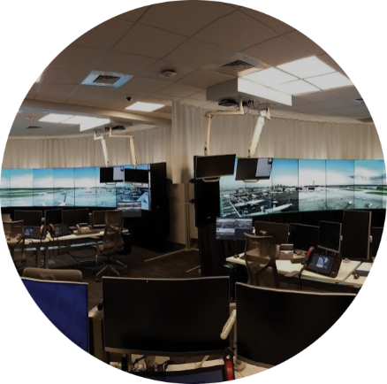
Digital or conventional tower
Saab Integrated Digital Tower Solution
r-TWR
Light
r-TWR
Regional
One product to support various Digital Tower needs (Civ/ Mil)
Toolbox of camera/ sensor solutions
Common architecture with I-ATS
Common support and maintenance cycle
Part of a global user community
r-TWR
Large
Complex
Airports
I-ATS
Automation
System
Contingency
Stand-alone
Complementary
r-TWR
Mil
The Saab
r-TWR
Digital Tower
Family
r-TWR
Deployable
r-TWR
Hybrid
3rd Party
Automation
r-TWR
Ramp Tower
Notes:
Niclas

Slide 2
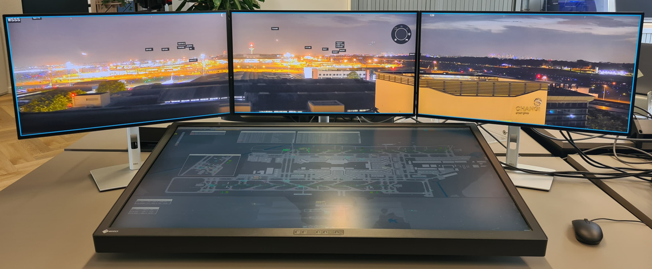
Saab integrated Digital Tower Suite (i-DTS)
Our field proven – full stack – r-TWR product with songle mouse operation with on-screen menues or operated via the I-ATS system
Our field proven – full stack – I-ATS solution on a single screen operation or tower pad
Notes:
Niclas

