Slide 1
Evaluation of the Noise Benefits from Performing CDO in TMA Using OpenSky Data
OpenSky Symposium, 2022-11-11
Henrik Hardell
Tatiana Polishchuk

Slide 2


Introduction and Background

Slide 3

Introduction
Exposure to aircraft noise affects the well-being of millions of people in Europe
WHO recommends L_{den} ≤ 45 dB
What is the noise reduction gained from performing CDO in TMA?
What are the savings in emissions and fuel from performing CDO in TMA?
Evaluation performed on three European airports (continuation of [1])

Slide 4
Airports
The airports:
  Dublin (EIDW) – point merge – rwy 28L
  Stockholm-Arlanda (ESSA) – vectoring – rwy 01R
  Vienna (LOWW) – trombone – rwy 16
220,000 to 260,000 aircraft movements annually
Operations inside TMA boundaries for Arlanda and Vienna. 50 NM circle for Dublin to cover eastbound arrivals.

Slide 5
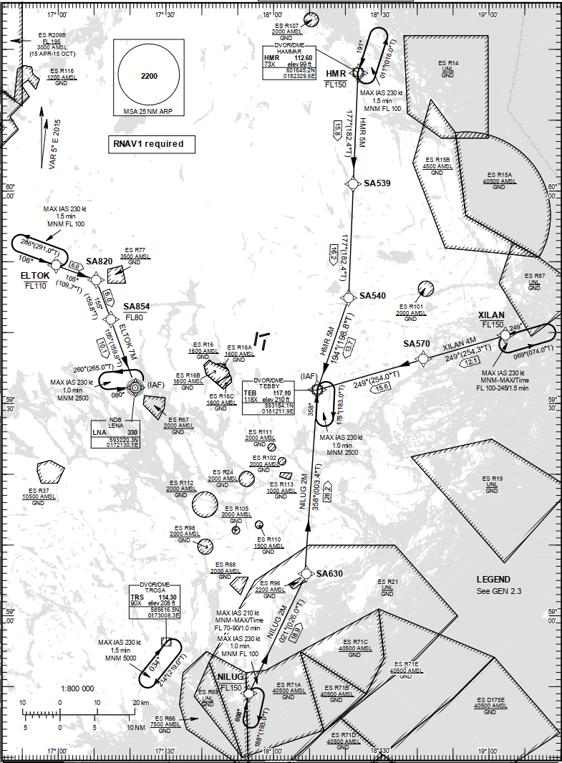
Stockholm-Arlanda – ESSA
Three runways
Pair of parallel runways (used during busy hours)
Mix of closed STARs and open STARs
Runway 01R – open loop vectoring only

Slide 6
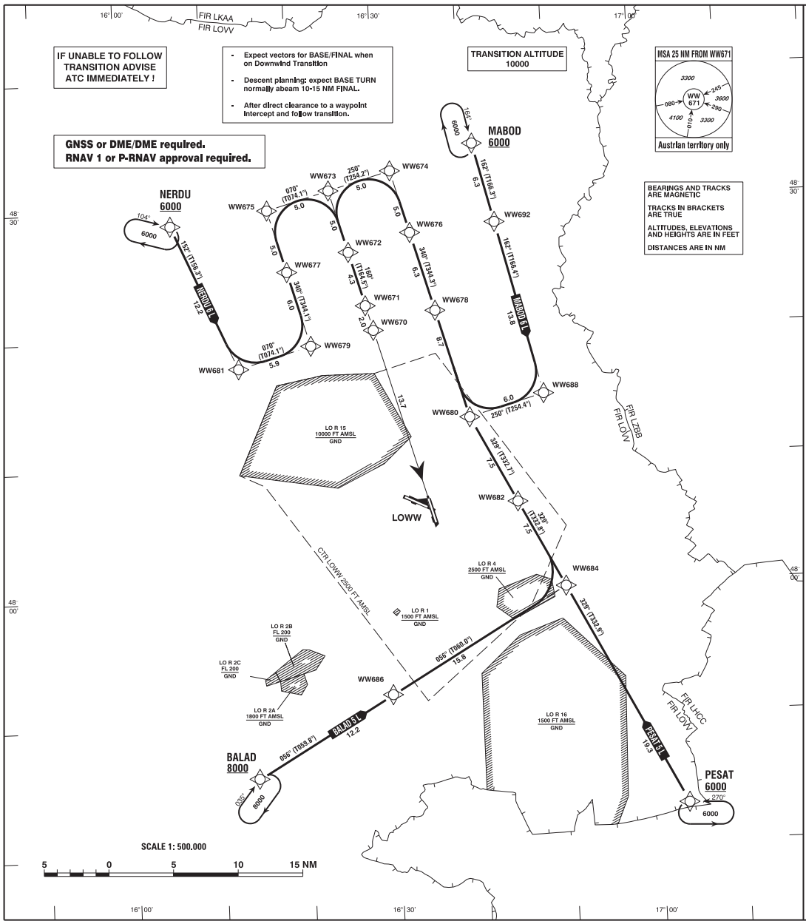
Vienna – LOWW
Two intersecting runways
Simultaneous usage of runways
Set of STARs and four IAFs
Waypoints for path stretching and shortcuts

Slide 7
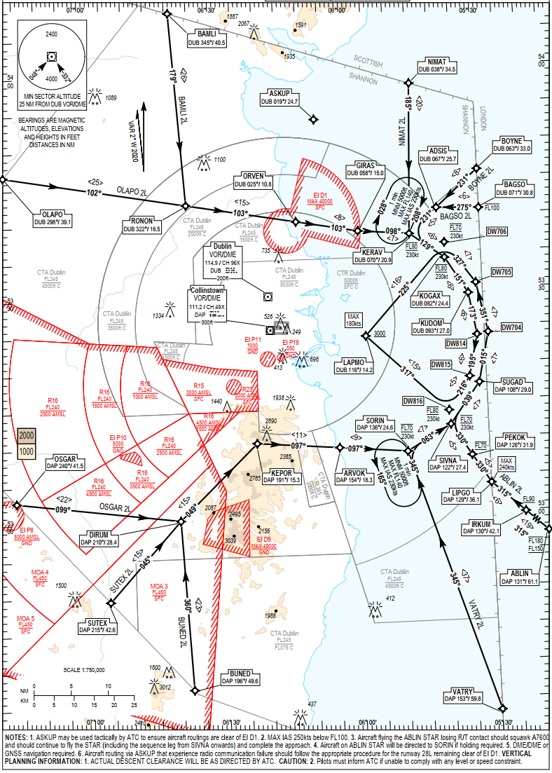
Dublin – EIDW
Two intersecting runways
Main runway 10R/28L (used 95 % time)
Sequencing legs in the shape of arcs for path stretching flown at level flight
Merge point before final approach segment

Slide 8
Methodology

Slide 9
Data
Historical database of the OpenSky Network
’States’ data representing the parts of the arriving flight trajectories inside TMA
  Month with the highest number of arrivals at our three airports
  Full four weeks of October 2019

Slide 10
Data Cleaning
    Fixing all incorrect positioning using linear interpolation
    Gaussian filter to smooth the altitudes
    Removing the trajectories:
      representing landings too far from the runway
      that are incomplete within TMA
      starting from an altitude lower than 600 m
      representing go arounds within TMA
      for some non-commercial flights

Slide 11
Dataset
    Same dataset as used in our previous paper [1]
    Peak-time periods in October 2019
    Average per hour time in TMA for each airport calculated (0.7 percentile removed)
    The rest of the values correspond to the hours which represent the peak time periods
    2587 flights for Dublin, 1045 for Arlanda and 1641 for Vienna

Slide 12
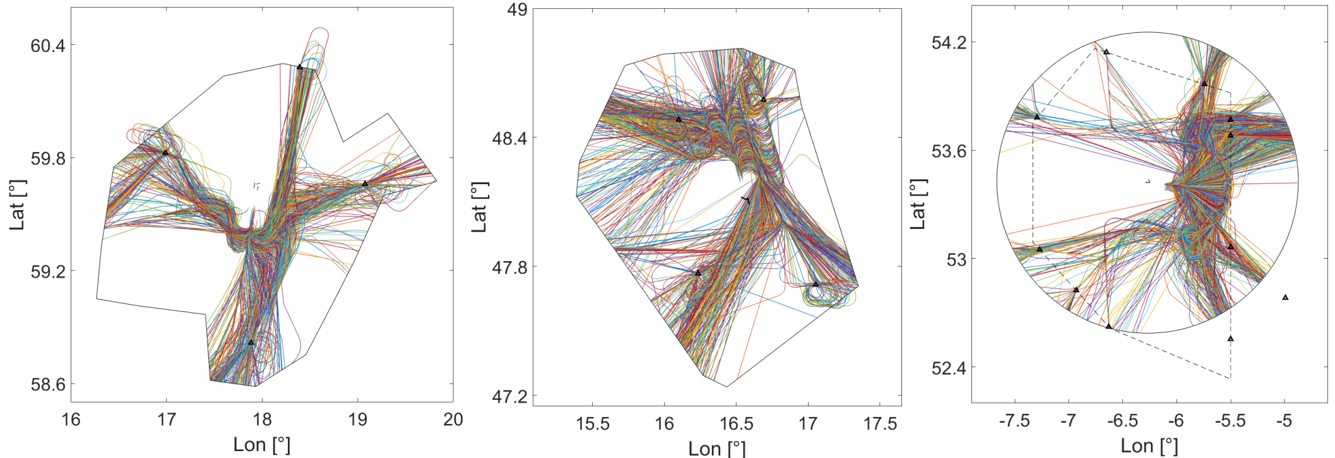
Dataset Trajectories
Arlanda
Vienna
Dublin

Slide 13
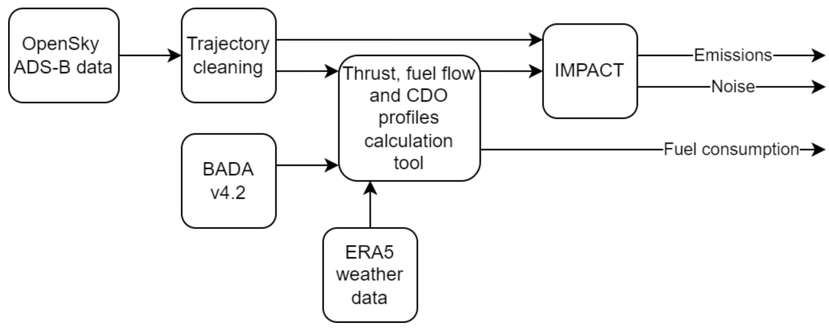
Methodology – Overview
    A unique reference CDO profile per flight
    Compare the calculated metrics for actual trajectories vs CDO
    BADA v4.2 is the core for performance modeling

Slide 14
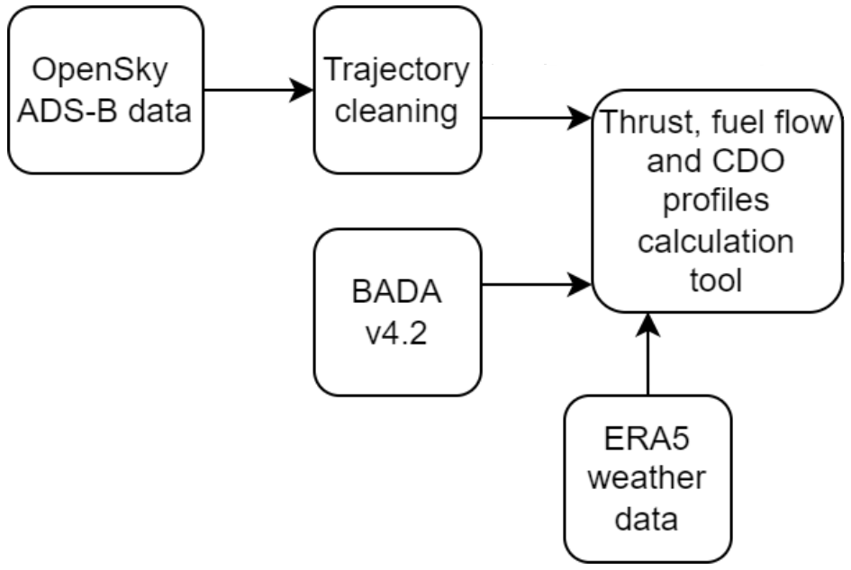
Performance modeling – Actual trajectories
    Total Energy Model (TEM) used to calculate
    the thrust
    Actual atmospheric conditions considered
    Flaps/slats and landing gear effects not considered

Slide 15
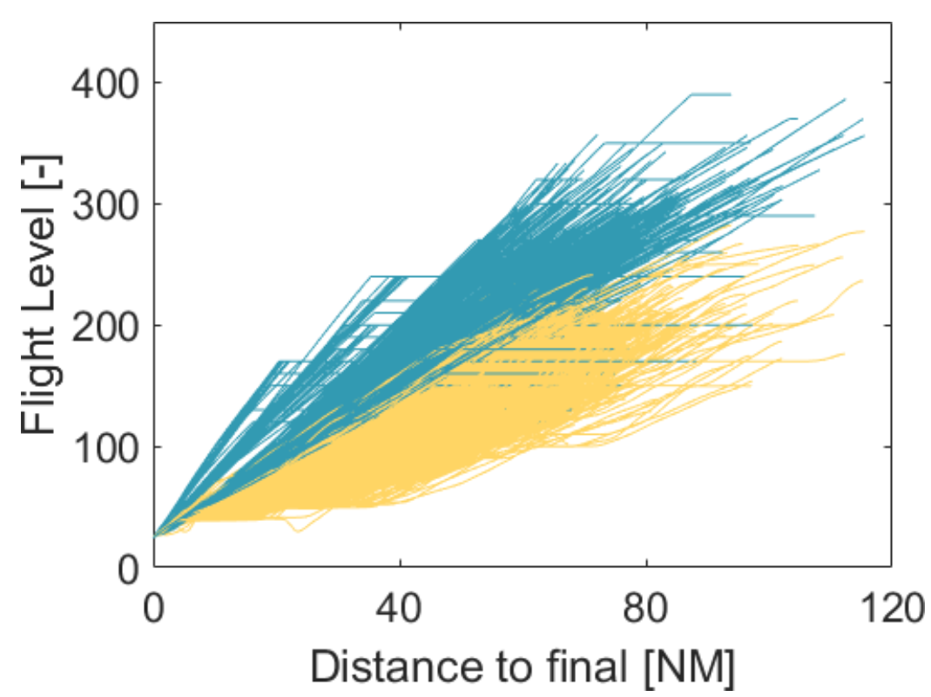
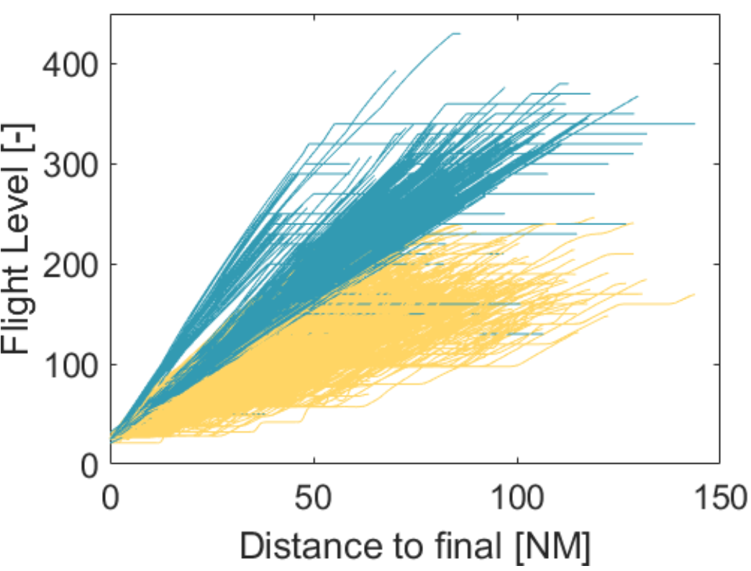
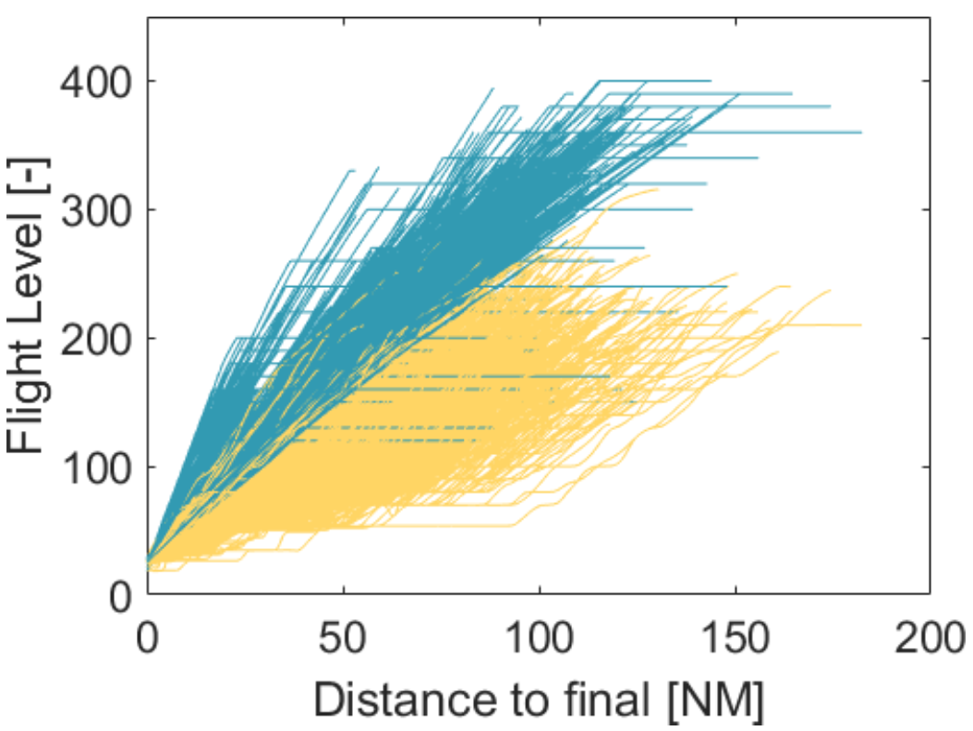
Performance modeling – CDO trajectories
    Engine idle thrust and no use of speed brakes
    Descent speed schedule formulas from BADA
    TEM used to find the vertical speed corresponding to the current idle thrust and speed
    Flaps/slats and landing gear effects not considered
    Actual atmospheric conditions considered
ESSA
LOWW
EIDW

Slide 16
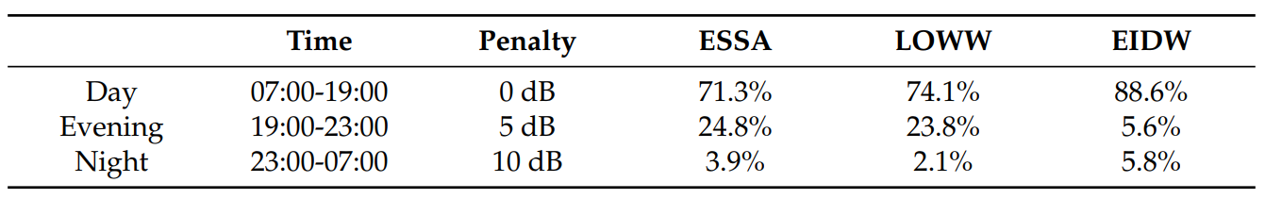
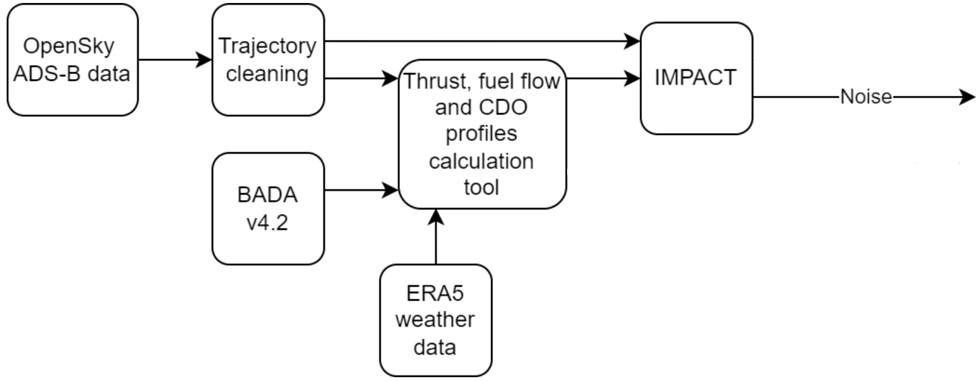
Noise Evaluation
Eurocontrol IMPACT
ANP data v2.3
ECAC Doc 29 4th edition
L_{den} (with penalties)
Standard atmosphere conditions
Distribution of a/c operations

Slide 17
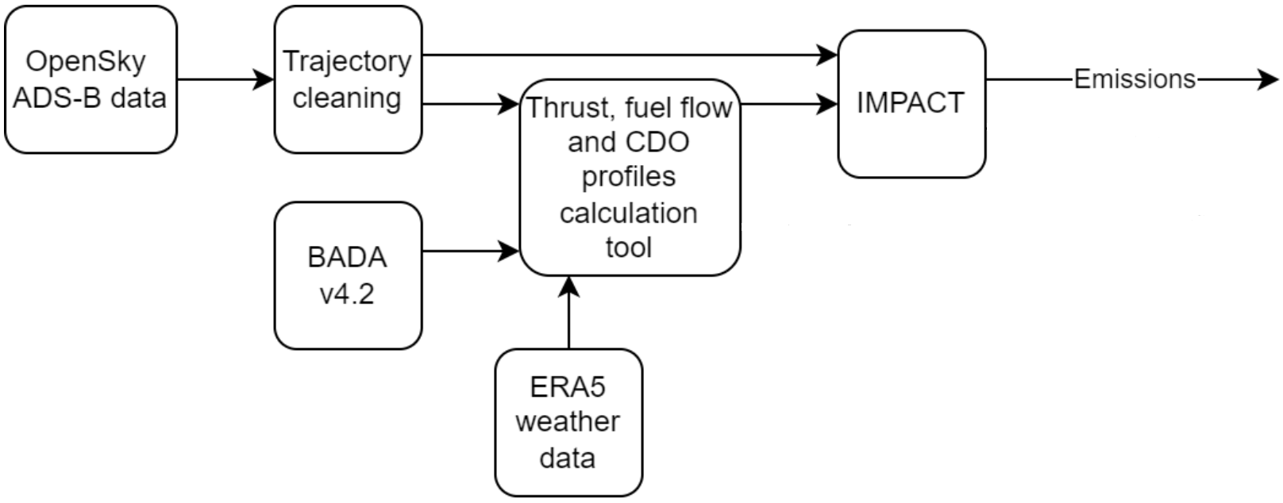
Emissions Evaluation
Eurocontrol IMPACT
CO2, NOx, SOx, HC, CO
ANP data v2.3
BADA v3.15 and v4.2
Standard atmosphere conditions

Slide 18
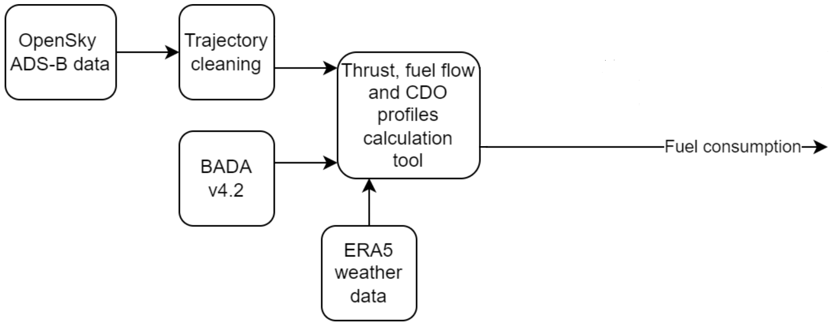
Fuel Evaluation
Fuel coefficient obtained from the thrust coefficient
Fuel flow calculated according to BADA formulas

Slide 19
Results

Slide 20
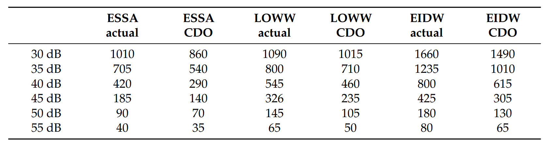
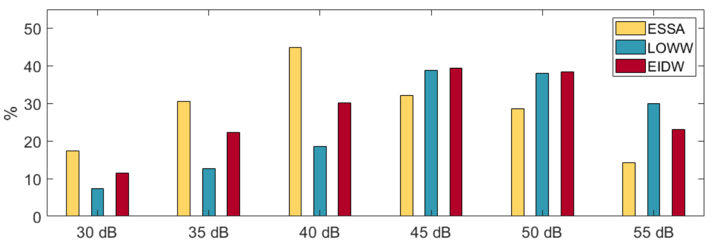
Noise – Overview
Areas covered (km²)
30 dB to 55 dB considered
>55 dB mostly coincides with final app.
Noise decrease at all levels observed
Additional exposed areas

Slide 21
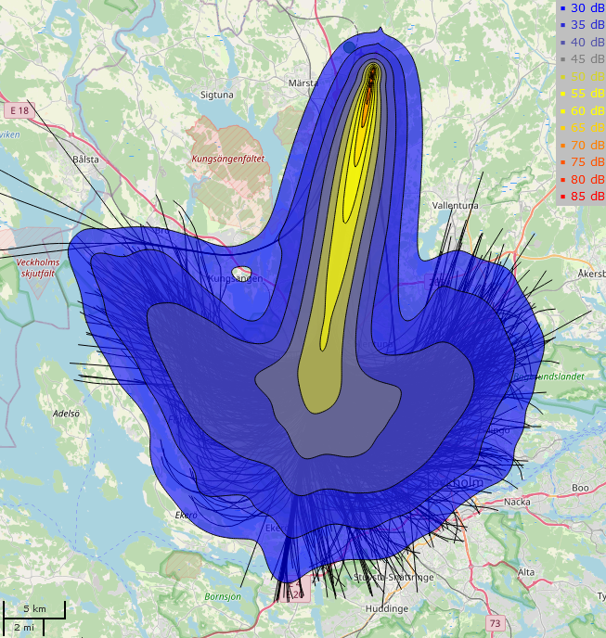
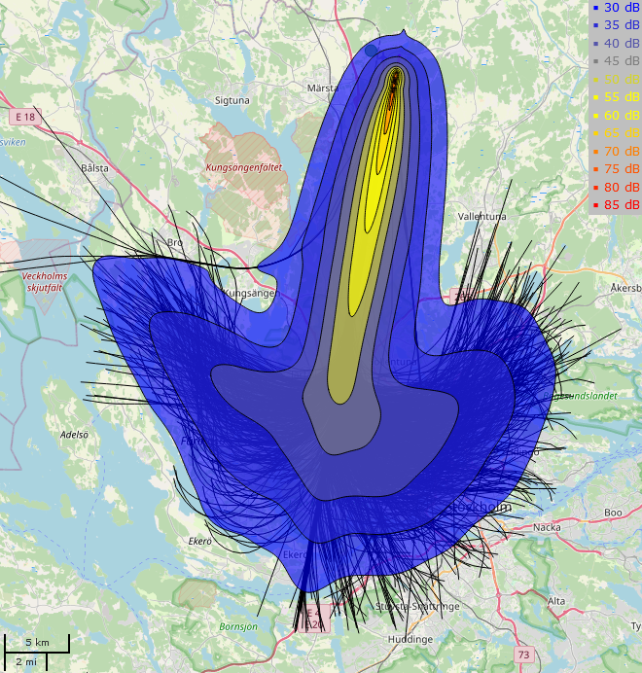
Noise – Arlanda
Actual
CDO
Noise level | Additional area
35 dB | 30%
40 dB | 45%
45 dB | 30%

Slide 22
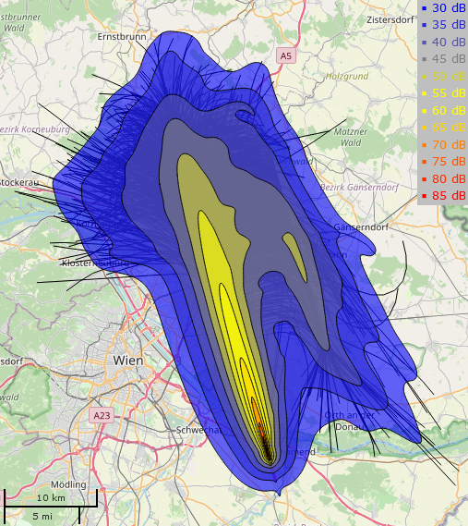

Noise – Vienna
Actual
CDO
Noise level | Additional area
45 dB | 38%
50 dB | 38%
55 dB | 30%

Slide 23
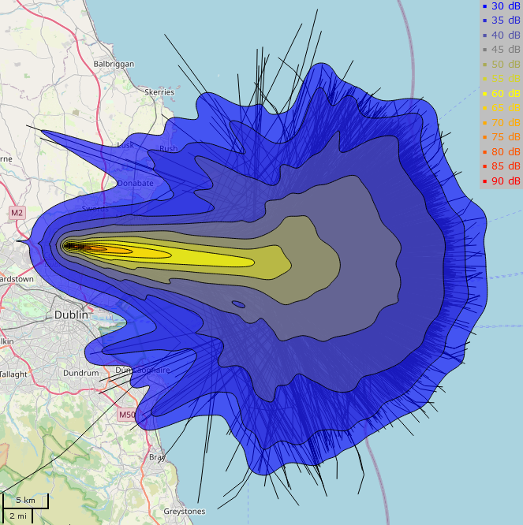
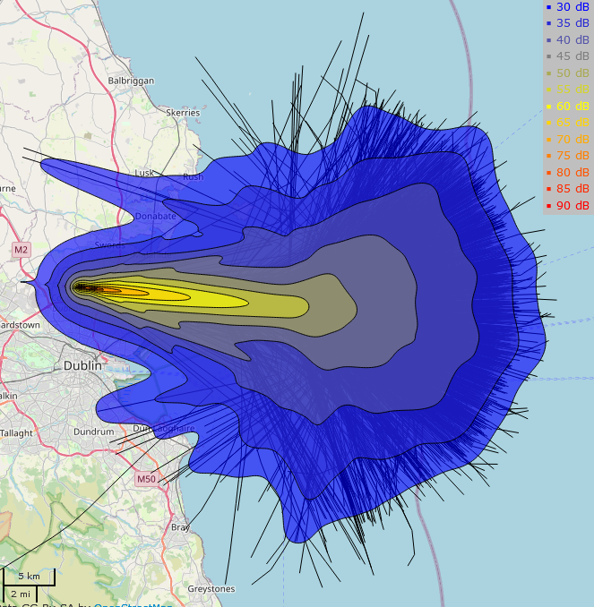
Noise – Dublin
Actual
CDO
Noise level | Additional area
40 dB | 30%
45 dB | 40%
50 dB | 40%

Slide 24
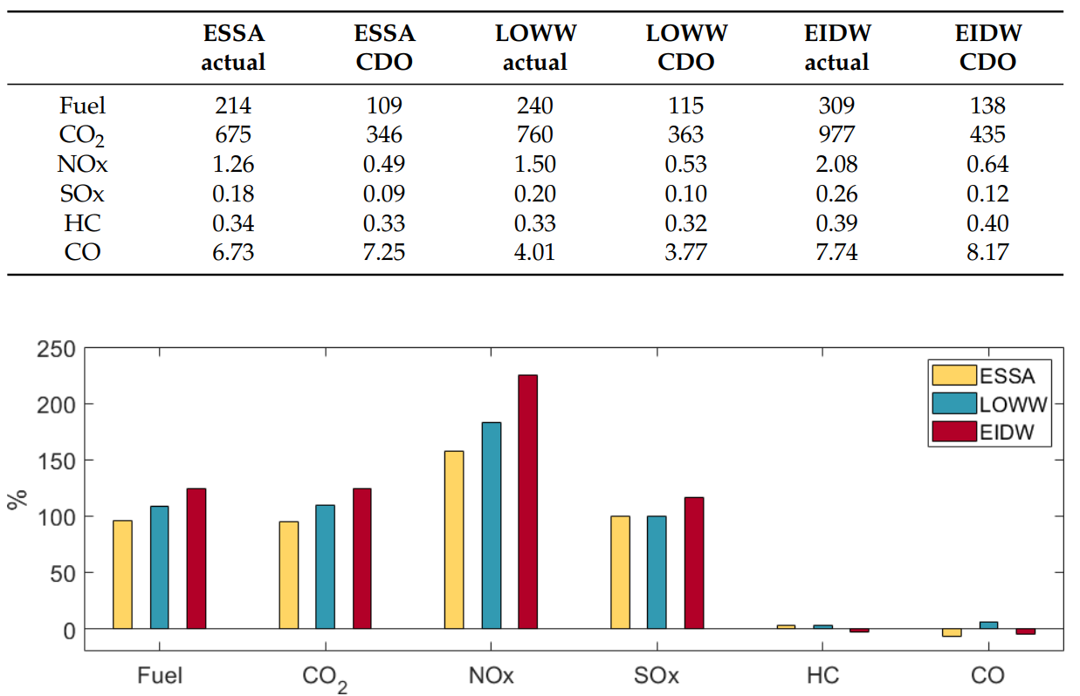
Emissions and fuel
Fuel and emissions
Reduced fuel burn and CO2, NOx
and SOx emissions from CDO
NOx savings most significant
Benefits in terms of HC and CO
emissions vary
Additional fuel and emissions

Slide 25
Conclusions and Future Work

Slide 26
Conclusions
CDO contributes to reduced noise at and above the harmful levels considered by the WHO
Fuel savings observed for all airports, when CDO performed
CO2, SOx, and NOx emissions reduced for CDO (greatest for NOx)
CO and HC emissions may increase due to CDO

Slide 27
Future Work
Study the trade-off between noise and fuel consumption
Evaluate the expected benefits provided by the optimized scenarios, where automatic traffic scheduling is applied

Slide 28
Thank you.

